Slide 1
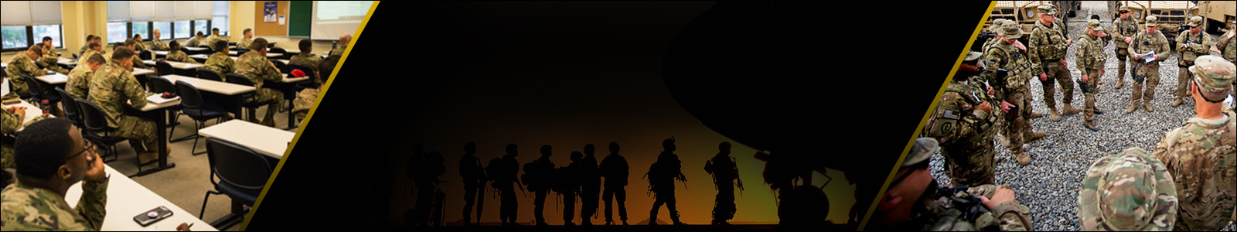
Course Map
ATN
DTMS
Help Desk
DTMS User Guide
Slide Presentation Description
Digital Training Management System
Preparatory Functions
Lesson ID: 150T-COMOPTNG / Version 4.2 (Modified)
June 2022
Notes:
INSTRUCTOR ONLY:
Primary instructor/facilitator Introductions – Introduce yourself and describe your professional experiences in DTMS. Introduce members of your team (alternate instructors/facilitators).
INSTRUCTOR NOTES:
This training is designed for 2-hours of classroom instructions and introduces you to DTMS Preparatory Functions.
Student introductions
have each of the students introduce themselves:
Rank & Name
Unit assignment
Duty position
Next slide

Slide 2
Terminal Learning Objective
Action: Demonstrate Operator Level Functionality Using the Digital Training Management System
Conditions: The Digital Training Management System (DTMS) is the Army’s Learning Management System (LMS) for recording individual, unit, and organizational training. Preparatory Functions are the essential functions that serve as the foundation for every other DTMS function. The DTMS preparatory functions unit is an in-course unit designed to allow learners to recall previous knowledge about navigating Army systems while using their previous knowledge and scaffold that knowledge to increase their skills, knowledge, and use of DTMS. This instruction is an online-based, flipped classroom instruction with practical applications, learning activities, small group exercises, and skills-based learning.
Standards: Demonstrate proper operator level functionality that best supports the company commander’s guidance; properly add, edit, and/or assign training locations; add, remove, assign platoon personnel; demonstrate the management of personnel, signature blocks, users, and assigned personnel in the DTMS; demonstrate proper data pull to manage reports and unit training proficiency statuses without error.
2
Notes:
INSTRUCTOR ONLY:
Instructor informs the students of the Learning Objectives. Instructor must pause to allow Soldiers time to read the Learning Objectives.
INSTRUCTOR NOTES:
You [the student] are required to demonstrate operator functionality for company level using the Digital Training Management System to manage unit training. This training assists in recording and data input into DTMS for: unit training plan, individual training records, assisting commanders with MET assessment completion, and weapons management and collective live fire readiness reporting.
Conditions: The Digital Training Management System (DTMS) is the Army’s Learning Management System (LMS) for recording individual, unit, and organizational training. Preparatory Functions are the essential functions that serve as the foundation for every other DTMS function. The DTMS preparatory functions unit is an in-course unit designed to allow learners to recall previous knowledge about navigating Army systems while using their previous knowledge and scaffold that knowledge to increase their skills, knowledge, and use of DTMS. This instruction is an online-based, flipped classroom instruction with practical applications, learning activities, small group exercises, and skills-based learning.
At the completion of this lesson, you [the student] will be able to:
Prepare the DTMS system for operation
Enter the training plan to schedule and manage events, event sets, checklists, calendars, and training schedules
Apply objective assessments to manage the unit METL
Demonstrate data input to manage individual weapons and Soldiers individual training records
Demonstrate data pull to manage reports and unit training proficiency statuses
Are there any questions?
Next slide

Slide 3
Instructional Lead-in
The Digital Training Management System (DTMS) is the Army’s Learning Management System (LMS) for recording individual, unit, and organizational training. Preparatory Functions are the essential functions that serve as the foundation for every other DTMS function. The DTMS preparatory functions unit is an in-course unit designed to allow learners to recall previous knowledge about navigating Army systems while using their previous knowledge and scaffold that knowledge to increase their skills, knowledge, and use of DTMS. This instruction is an online-based, flipped classroom instruction with practical applications, learning activities, small group exercises, and skills-based learning.
DTMS Operators must possess basic computer skills of computer operating systems. Additionally, DTMS Operators must possesses core competencies which include Access to Army Networks & access to DTMS. DTMS operations need to show resiliency to meet the timely data entry requirements even though they are not receiving timely data, routine or sporadic system outages, and during busy times of multiple exercises requiring simultaneous input into DTMS.
3
Notes:
INSTRUCTOR NOTES: "The purpose of unit training is to build and maintain ready units to conduct unified land operations for combatant commanders. Good training gives Soldiers confidence in their abilities and the abilities of their leaders, forges trust, and allows the unit to adapt readily to new and different missions.
Are there any questions?
Next slide

Slide 4
Preparatory Functions
The Preparatory Functions consists of the following lessons:
Locations
Platoon Manager
Signature Blocks
User Management Overview
Manage Personnel (Soldier Manager menu)
4
Notes:
Reference: Digital Training Management System (https://dtms.army.mil).
INSTRUCTOR ONLY:
The instructor/facilitator must demonstrate the functionality on a live network (depending on network availability). When network connectivity is not available, the instructor/facilitator must initiate contingency plan.
Instructor will use this time to transition to the Preparatory Functions lessons.
INSTRUCTOR NOTES:
The Preparatory Functions are necessary to properly use DTMS to its fullest potential. There are certain functions in DTMS that need to be setup prior to attempting to perform other functions. Items such as Locations and Signature Blocks are necessary for developing proper training schedules. Platoon Manager allows the building of subordinate units to better manage personnel records at the platoon or below levels. User Management will primarily be used by Managers to give users at all levels access to DTMS.
During this lesson we will demonstrate the following menus:
Locations
Platoon Manager
Signature Blocks
User Management Overview
Manage Personnel
Menu items such as Locations and Signature Blocks are necessary for developing proper Training Schedules. Platoon Manager allows the building of subordinate units to better manage personnel records at the platoon or below levels. User Management will primarily be used by managers to give Users at all levels access to DTMS.
Are there any questions?
Next slide

Slide 5
Locations
During this lesson, we will demonstrate the Preparatory Functions by accessing the following Locations topics:
Add a Location
Edit a Location
Delete a Location
5
Notes:
Reference: Digital Training Management System (https://dtms.army.mil).
INSTRUCTOR ONLY: The instructor/facilitator must demonstrate the functionality on a live network (depending on network availability). When network connectivity is not available, the instructor/facilitator must initiate contingency plan.
INSTRUCTOR NOTES: During this lesson, we will demonstrate the Locations functionality by accessing the following topics:
Add a Location
Edit a Location
Delete a Location
Are there any questions?
Next slide

Slide 6
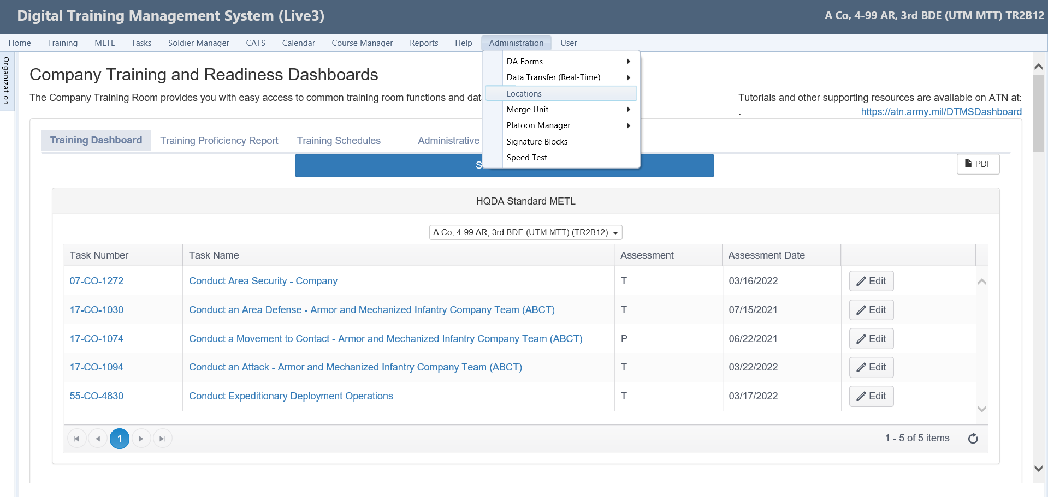
Locations
Step 1
Navigate to the Administration menu.
Select Locations from the drop-down menu.
The screen refreshes to the Lookup Management page.
NOTE
The Administration menu provide users with the ability to perform some preparatory functions necessary to properly use DTMS to its fullest potential.
There are certain functions in DTMS that need to be setup prior to attempting to perform other functions.
6
Notes:
Reference: Digital Training Management System (https://dtms.army.mil).
INSTRUCTOR ONLY: The instructor/facilitator must demonstrate the functionality on a live network (depending on network availability). When network connectivity is not available, the instructor/facilitator must initiate contingency plan.
INSTRUCTOR NOTES:
Locations
Step 1
Navigate to the Administration menu.
Select Locations from the drop-down menu.
The screen refreshes to the Lookup Management page.
NOTE
The Administration menu provide users with the ability to perform some preparatory functions necessary to properly use DTMS to its fullest potential.
There are certain functions in DTMS that need to be setup prior to attempting to perform other functions.
Next slide

Slide 7
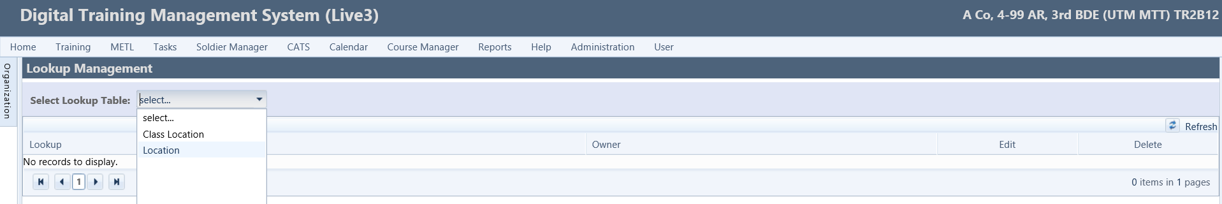

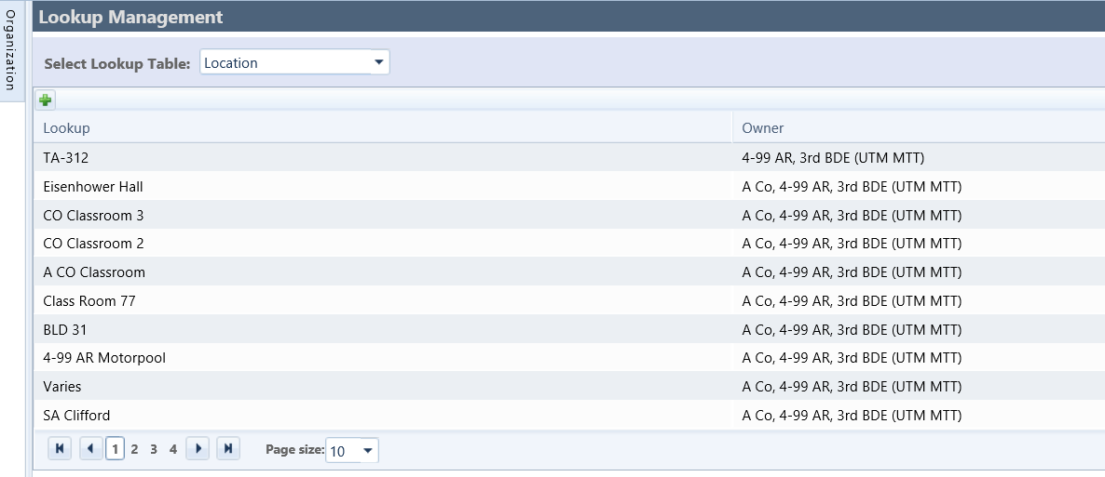
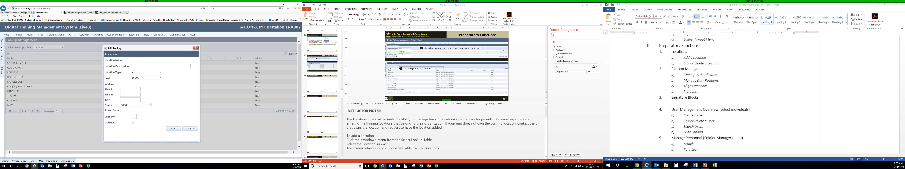
Add Location
Step 2
Click the Select Lookup Table drop-down menu.
Select Location.
Screen refreshes and displays previously added locations.
Step 3
Click the Plus (+) icon to add a Location.
Screen refreshes to the Edit Lookup window.
Step 4
Enter required entries to add a location:
Location Name: TA54
Location Type: Select Company Area from drop-down menu.
Is Active: Place a checkmark in the checkbox.
Select the Save button to record the location.
The screen refreshes and the new location is added.
7
Notes:
Reference: Digital Training Management System (https://dtms.army.mil).
INSTRUCTOR ONLY: The instructor/facilitator must demonstrate the functionality on a live network (depending on network availability). When network connectivity is not available, the instructor/facilitator must initiate contingency plan.
INSTRUCTOR NOTES:
The Locations menu allow units the ability to manage training locations when scheduling events. Units are responsible for entering the training locations that belong to their organization. If your unit does not own the training location, contact the unit that owns the location and request to have the location added.
Step 2
Click the Select Lookup Table drop-down menu.
Select Location.
Screen refreshes and displays previously added locations.
NOTE 1
The Class Location only applies to Course Manager and the Location applies to the unit used in scheduling.
NOTE 2
It is recommended that units add only the locations they control. When adding a location to an event, there is a de-confliction capability in DTMS that will alert users if they are trying to use the same location.
Add Location
Step 3
Click the Plus icon to add a location.
The screen refreshes to the Edit Lookup window.
Step 4
Enter required entries to add and a location:
Location Name: TA54
Location Type: Select Company Area from drop-down menu.
Is Active: Place a checkmark in the checkbox.
Select the Save button to record the location.
The screen refreshes and the new location is added.
NOTE 3
There are times when locations have been added that are duplicated at different echelons. Locations can only be deleted at the organization that built them. Be cautious when deleting locations, since the location may be linked to an event on the calendar. It is better to uncheck the box next to “Is Active” to remove the location from the drop-down menu rather than deleting the entire location, since it can then leave previous training schedules without locations for the events that were linked to the location.
Edit Location (Not shown on illustration)
Click the Pencil icon.
The screen refreshes and opens the Edit Lookup window.
Make any necessary changes.
Click the Save button to record your changes.
Delete Location (Not shown on illustration)
Click the Delete icon.
Dialog box opens to confirmation your selection.
Click the OK button
Are there any questions?
Next, we will demonstrate the Platoon Manager functionality.
Next slide

Slide 8
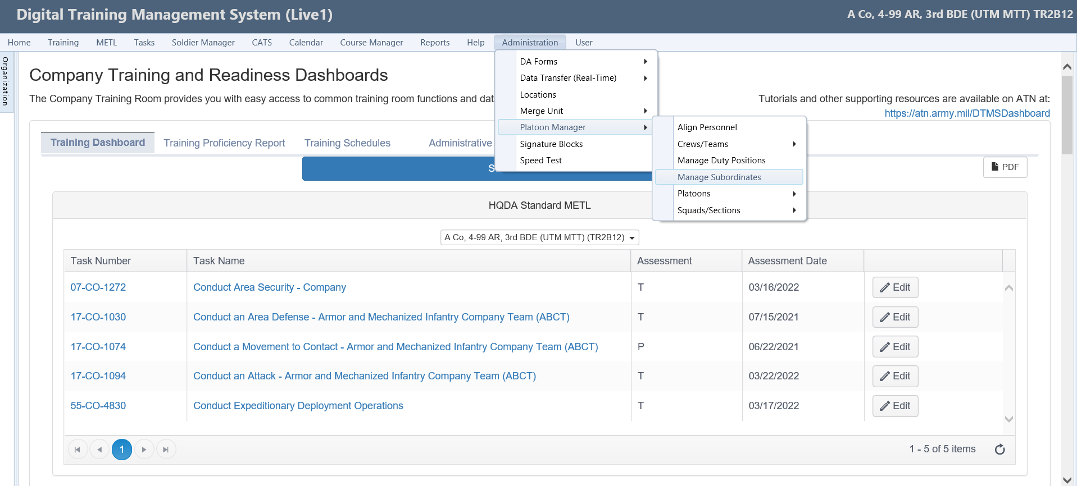
Platoon Manager
Navigate to the Administration menu.
Hover over Platoon Manager from the drop-down menu.
Select Manage Subordinates.
NOTE
The Platoon Manager function is valid only for company level DTMS users. Platoon Manager allow users the ability to create subordinate PLT’s, SQD’s and Teams; assign personnel to those subordinate units and assign duty positions to those Soldiers within the Platoons.
8
Notes:
Reference: Digital Training Management System (https://dtms.army.mil).
INSTRUCTOR ONLY: The instructor/facilitator must demonstrate the functionality on a live network (depending on network availability). When network connectivity is not available, the instructor/facilitator must initiate contingency plan.
INSTRUCTOR NOTES:
Platoon Manager
NOTE
Platoon, Squad/Section, and Crew/Team drop-downs will only appear if that type of subordinate unit has been added using Platoon Manager.
The Platoon Manager function is valid only for company level DTMS users. Platoon Manager allow users to create subordinate PLT’s, SQDs and Teams; assign personnel to those subordinate units and assign duty positions to those Soldiers within the platoons. During this lesson we will demonstrate the following menus: 1) Manage Subordinates, 2) Manage duty positions, 3) Align personnel, and 4) Subordinate unit menus (if built).
First, we will demonstrate how to Manage Subordinates.
Manage Subordinates
Access the Manage Subordinates fly-out menu.
Hover cursor over the Administration menu, the drop-down submenu opens.
Hover cursor over the Platoon Manager submenu, the fly-out menu opens.
Click the Manage Subordinates fly-out menu.
The screen refreshes and the Manage Platoons & Subordinate Organizations window opens.
Next slide

Slide 9
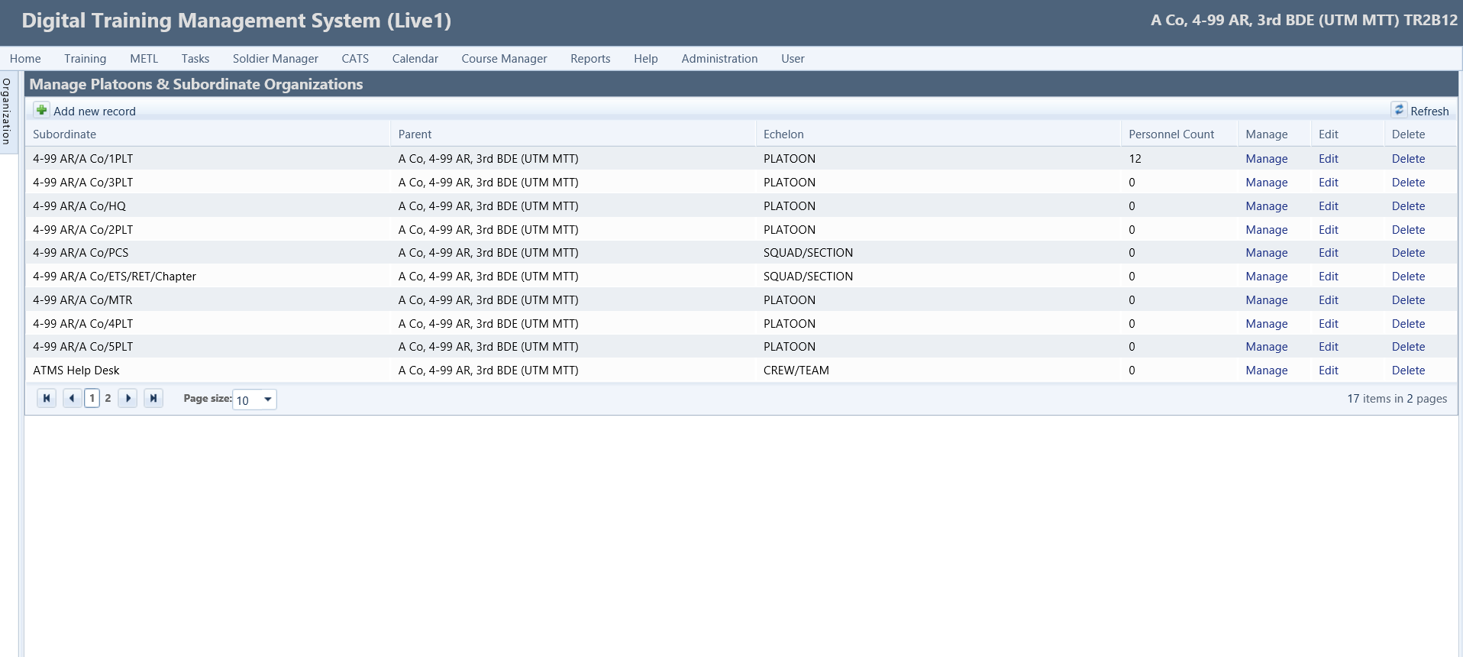
Manage Subordinates
NOTE
Units should establish a naming convention for subordinate units to clearly identify a subordinate when viewed by higher echelon DTMS Managers and leaders.
It is recommended that the name of a platoon include BN/CO/PLT at a minimum. Some units choose to include BDE or DIV in the naming convention.
9
Notes:
Reference: Digital Training Management System (https://dtms.army.mil).
INSTRUCTOR ONLY: The instructor/facilitator must demonstrate the functionality on a live network (depending on network availability). When network connectivity is not available, the instructor/facilitator must initiate contingency plan.
INSTRUCTOR NOTES:
Manage Subordinates
From the Manage Platoons & Subordinate Organizations window users have the ability to Add new record, Manage, Edit, Delete Subordinate Units, and Manage Personnel Assignments/Duty Positions for the subordinate units.
Next, we will add a new record.
Next slide

Slide 10
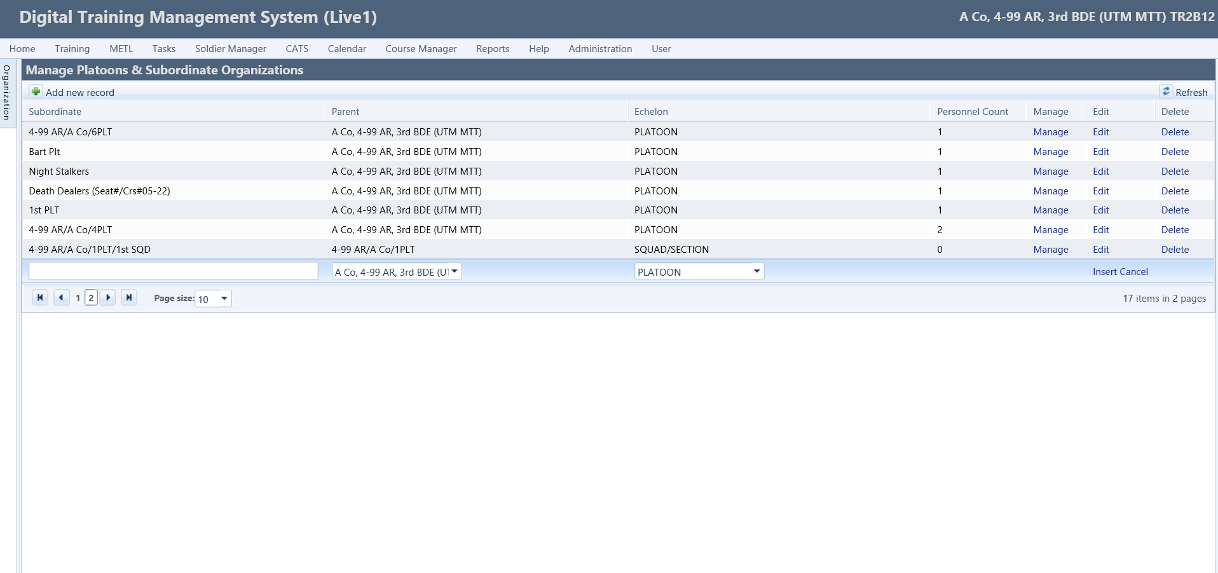
Add New Record
To add new record, click the Plus (+) icon.
The screen refreshes and an additional row opens.
Enter the Subordinate Unit name in the text field.
Select the Parent Unit from the drop-down menu.
Select the Echelon of the subordinate platoon/section/squad from the drop-down menu.
Select the Insert button to record the new record.
NOTE
Every company level unit should add a subordinate for personnel that are no longer in the unit (PCS) and one for personnel that are no longer in the military (ETS/Chapter/RET). By placing personnel in these subordinates, a unit can identify the personnel that are no longer present and should not be included in statistics.
10
Notes:
Reference: Digital Training Management System (https://dtms.army.mil).
INSTRUCTOR ONLY: The instructor/facilitator must demonstrate the functionality on a live network (depending on network availability). When network connectivity is not available, the instructor/facilitator must initiate contingency plan.
INSTRUCTOR NOTES:
Add New Record
To add new record, click the (+) Plus icon.
The screen refreshes and an additional row opens.
Enter the Subordinate Unit name in the text field.
Select the Parent Unit from the drop-down menu.
Select the Echelon of the subordinate platoon/section/squad from the drop-down menu.
Select the Insert button to record the new record.
Personnel can be aligned with the subordinate unit using the Manage button next to each Subordinate. This will lead to the same location shown later in the discussion of Aligning personnel and using the subordinate unit menus.
Every company level unit should add a subordinate for personnel that are no longer in the unit (PCS) and one for personnel that are no longer in the military (ETS/Chapter/RET). By placing personnel in these subordinates, a unit can identify the personnel that are no longer present and should not be included in statistics.
Are there any questions?
Next, we will demonstrate how to edit/delete subordinates.
Next slide

Slide 11
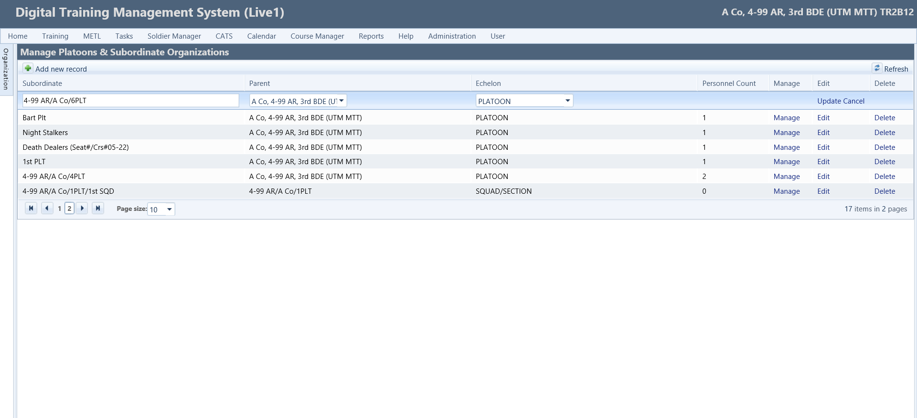
Manage Subordinates
To edit a subordinate, Click on the Edit button for the appropriate subordinate.
The screen refreshes, and the fields become editable.
Edit the text field by changing the subordinate name.
Change the Parent unit by selecting from the drop-down menu.
Change the Echelon by selecting from the drop-down menu.
Click the Update button to record the changes.
NOTE
If personnel do not show up in the Integrated Total Army Personnel Database (ITAPdB) for five consecutive days, they are automatically removed from DTMS. This has improved the previous issue of personnel remaining in units after they leave the military.
11
Notes:
Reference: Digital Training Management System (https://dtms.army.mil).
INSTRUCTOR ONLY: The instructor/facilitator must demonstrate the functionality on a live network (depending on network availability). When network connectivity is not available, the instructor/facilitator must initiate contingency plan.
INSTRUCTOR NOTES:
Edit Subordinate
To edit a subordinate, click the Edit button for the appropriate subordinate.
The screen refreshes, and the fields become editable.
Edit the text field by changing the subordinate name.
Change the Parent unit by selecting from the drop-down menu.
Change the Echelon by selecting from the drop-down menu.
Click the Update button to record the changes.
If personnel do not show up in the Integrated Total Army Personnel Database (ITAPdB) for five consecutive days, they are supposed to be removed from DTMS. This has improved the previous issue of personnel remaining in units after they leave the military.
Delete Subordinates (Not shown on illustration)
NOTE
Before deleting a subordinate unit, ensure no personnel are aligned with that subordinate unit.
To delete a subordinate, click the Delete button.
A dialog box opens to confirm your selection.
Click the OK button to delete the subordinate.
Are there any questions? …Solicit learner response and gain feedback from learning session (Below)
Solicit Learner Response and Gain Feedback: Ask the students an open-ended question about the topic. Encourage student dialogue and interaction with each other. The instructor will inject as required to assist learning and student engagement.
Next, we will demonstrate how to Manage Duty Positions.
Next slide

Slide 12
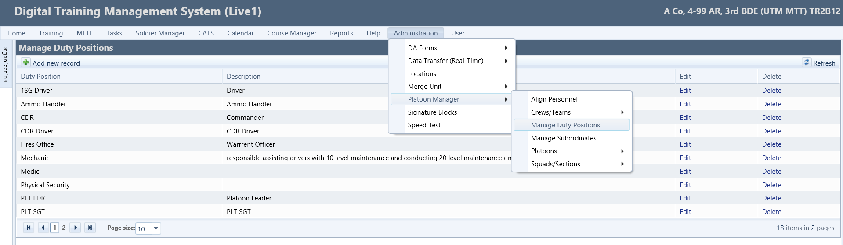
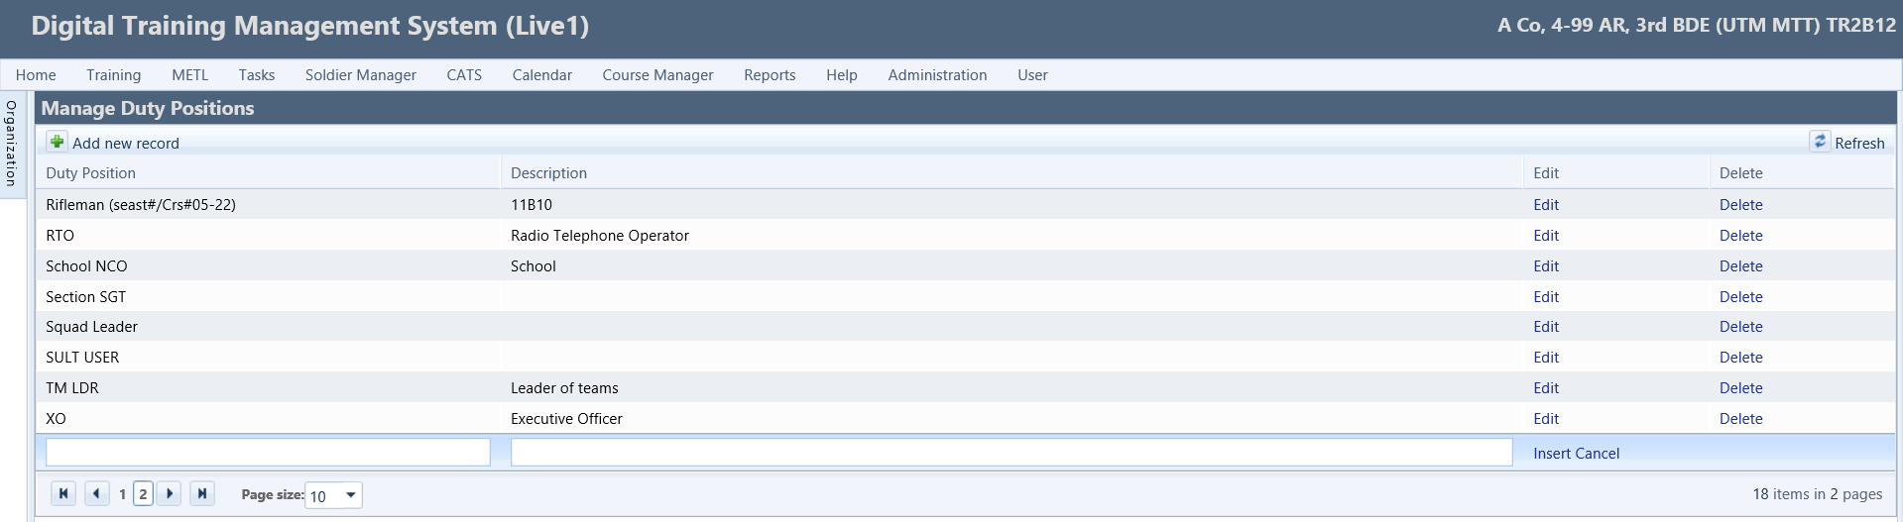
Manage Duty Positions
Step 1
Navigate back to the Administration menu.
Hover cursor over Platoon Manager, click the Manage Duty Positions fly-out.
Step 2
To add new record, click the Add new record icon. The screen refreshes and opens the Manage Duty Positions window.
Step 3
Enter the Duty Position in the text box.
Enter the Description in the text box.
Click the Insert button to save new record.
Enter Duty Position Here
Enter Description Here
12
Notes:
Reference: Digital Training Management System (https://dtms.army.mil).
INSTRUCTOR ONLY: The instructor/facilitator must demonstrate the functionality on a live network (depending on network availability). When network connectivity is not available, the instructor/facilitator must initiate contingency plan.
INSTRUCTOR NOTES:
Manage Duty Positions
The Manage Duty Positions allow users the ability to create a duty position that can also apply to subordinate units. Not all units use Duty Positions and this should be based on SOP. If Duty Positions are built in this location, they can be assigned to personnel when assigning them to subordinate units.
Add New Record
Step 1
Navigate back to the Administration menu.
Hover cursor over Platoon Manager, click the Manage Duty Positions fly-out.
Step 2
To add a new record, click the Add new record icon.
The screen refreshes and opens the Manage Duty Positions window.
Step 3
Enter the Duty Position in the text box.
Enter the Description in the text box.
Click the Insert button to save new record.
Edit Duty Position (Not illustrated on screenshot)
To edit a duty position, click the Edit button.
The screen refreshes and the selected Duty Position and Description are editable.
Edit as needed, click the Update button to save changes.
Delete Duty Position (Not illustrated on screenshot)
To delete a duty position, click the Delete icon.
A dialog box opens to confirmation your selection.
Click the OK button to delete the duty position.
Are there any questions?
Next, we will demonstrate how use the Align Personnel functionality.
Next slide

Slide 13
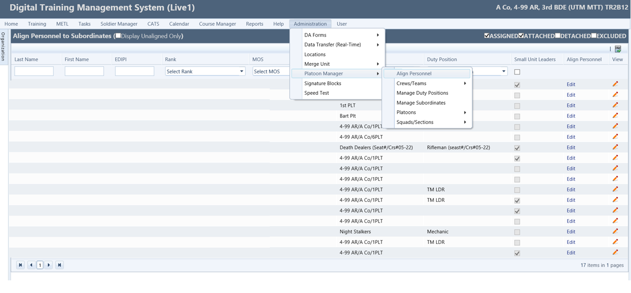
Align Personnel
Step 1
Hover cursor over the Administration menu, the drop-down submenu opens.
Hover cursor over the Platoon Manager submenu, the fly-out menu opens.
Click the Align Personnel fly-out menu.
The screen refreshes and the Align Personnel to Subordinates window opens.
Step 2
Either search for a Soldier by entering their Last Name and First Name or click Edit under the Align Personnel column to align them to a subordinate.
13
Notes:
Reference: Digital Training Management System (https://dtms.army.mil).
INSTRUCTOR ONLY: The instructor/facilitator must demonstrate the functionality on a live network (depending on network availability). When network connectivity is not available, the instructor/facilitator must initiate contingency plan.
INSTRUCTOR NOTES:
Align Personnel
The Align Personnel allow users the ability to edit personnel alignments within the subordinate units. It lists all Soldiers in your company and displays the Subordinate Unit they are aligned to (if applicable) and their Duty Position within the subordinate unit.
Step 1
Hover cursor over the Administration menu, the drop-down submenu opens.
Hover cursor over the Platoon Manager submenu, the fly-out menu opens.
Click the Align Personnel fly-out menu.
The screen refreshes and the Align Personnel to Subordinates window opens.
Step 2
Either search for a Soldier by entering their Last Name and First Name or click Edit under the Align Personnel column to align them to a subordinate.
NOTE
The Platoon Leader is not based on position, rather on the designation that this individual should be able to
update records for the personnel in that subordinate unit.
Edit Personnel
This process is how to Align personnel. Select the checkbox if the Soldier is a Platoon Leader or should be able to update records for the personnel in that subordinate unit. Additional options include, a Pencil icon that gives you the ability to view the Soldier’s ITR and Excel icons to export a roster.
Are there any questions?
Next, we will demonstrate the Platoons functionality.
Next slide

Slide 14
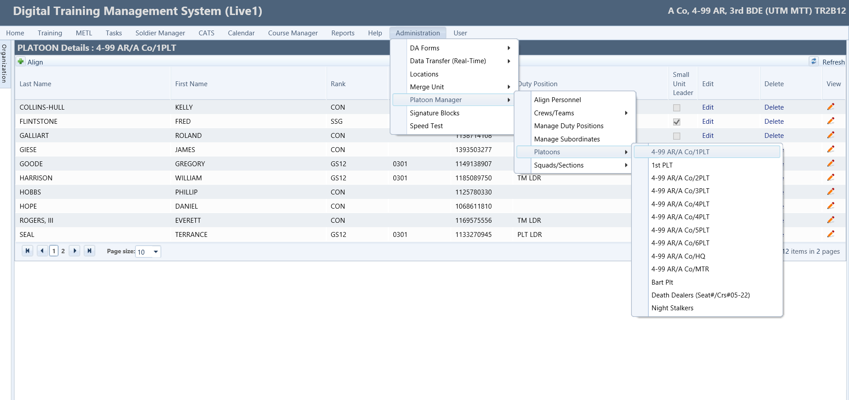
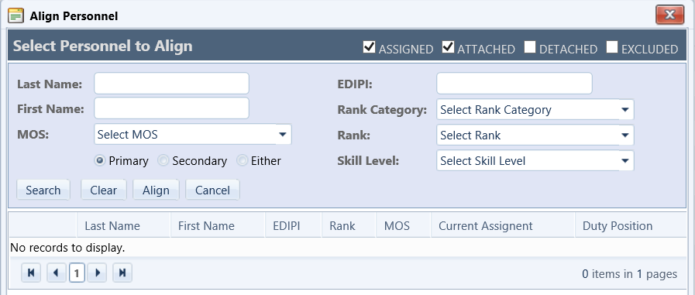
Platoons
Step 2
To add personnel click the Align icon, the Align Personnel window opens.
Step 1
Navigate back to the Administration menu.
Hover cursor over Platoon Manager, then Platoons, click the desired platoon fly-out.
Step 3
Use the search filters to refine your search or click the Search button to display available personnel.
14
Notes:
Reference: Digital Training Management System (https://dtms.army.mil).
INSTRUCTOR ONLY: The instructor/facilitator must demonstrate the functionality on a live network (depending on network availability). When network connectivity is not available, the instructor/facilitator must initiate contingency plan.
INSTRUCTOR NOTES:
Platoons
The Platoons fly-out menu appears only when Subordinate units have been created and personnel are aligned to the proper subordinate units. Once the subordinate units are created and personnel are aligned, you must log out and log back in to DTMS to activate the fly-out menu. Once the fly-out menu is activated a list of subordinate units will appear. When a subordinate unit is selected, it displays the roster of personnel in that unit. Additional options include Align Personnel, Edit, Delete, or View the Soldier’s ITR.
Add Personnel to the Platoon
Step 1
Navigate back to the Administration menu.
Hover cursor over Platoon Manager, then Platoons, click the desired platoon fly-out.
Step 2
To Add Personnel to the subordinate platoon, click the Align icon.
The screen refreshes and the Align Personnel window opens.
Step 3
Use the filters to refine your search or click the Search button to display a roster of available personnel to align.
Place checkmarks in the appropriate checkboxes next to selected personnel.
Select the Align button to add the personnel to the roster.
The screen refreshes and the personnel are added to the roster.
Additional options include an Edit button, a Delete button, and a View icon to open the Soldier’s ITR.
Are there any questions?
Next, we will demonstrate Signature Blocks.
Next slide

Slide 15
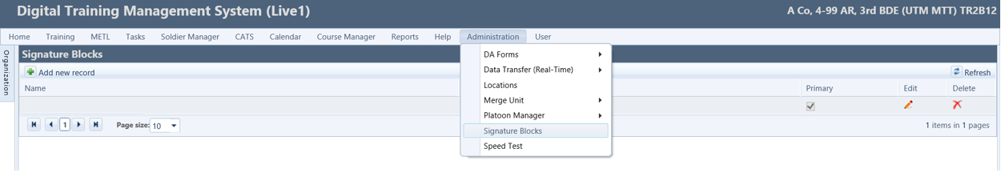
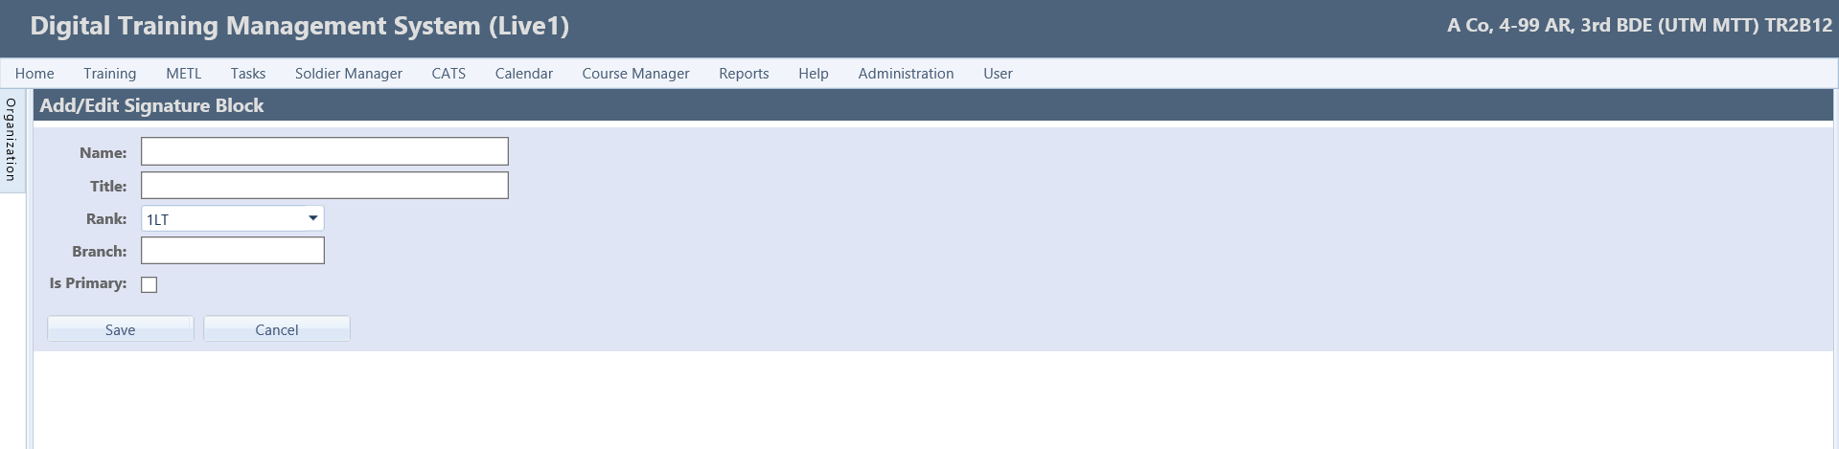
Signature Blocks
Step 2
To add new record, click the Add new record icon and the Add/Edit Signature Block window opens.
Step 1
Navigate back to the Administration menu.
Click on Signature Blocks.
Step 3
Enter the relevant information and select the Save button.
NOTE
See AR 25-50 for signature block format. Signature blocks are printed on training schedules only.
15
Notes:
Reference: Digital Training Management System (https://dtms.army.mil).
INSTRUCTOR ONLY: The instructor/facilitator must demonstrate the functionality on a live network (depending on network availability). When network connectivity is not available, the instructor/facilitator must initiate contingency plan.
INSTRUCTOR NOTES:
Signature Blocks
The Signature Blocks menu allows users the ability to build the Commander’s Signature block. Signature blocks will be printed on the training schedules. The commander for the organization is the only one that should be added here. An alternate approval authority can also have a signature block, but this is not normally necessary since the XO can sign for the commander as long as there is a memo signed by the commander designating signature authority.
Add New record
Step 1
Navigate back to the Administration menu.
Click on Signature Blocks.
Step 2
To add new record, click the Add new record icon and the Add/Edit Signature Block window opens.
Step 3
Enter the relevant information and select the Save button to save the signature block.
The screen refreshes and the signature block is added.
NOTE
See AR 25-50 for signature block format. Signature blocks are printed on training schedules only.
Edit Signature Block (Not illustrated on screenshot)
Click on the Pencil icon.
The screen refreshes to the Add/Edit Signature Block page.
Make the necessary edits.
Click the Save button to save the signature block.
The screen refreshes and the signature block is saved.
Delete Signature Block (Not illustrated on screenshot)
Click the Delete icon.
A dialog box opens to confirm your selection.
Click the OK button to delete the signature.
Are there any questions?
Next, we will discuss the User Management functionality.
Next slide

Slide 16
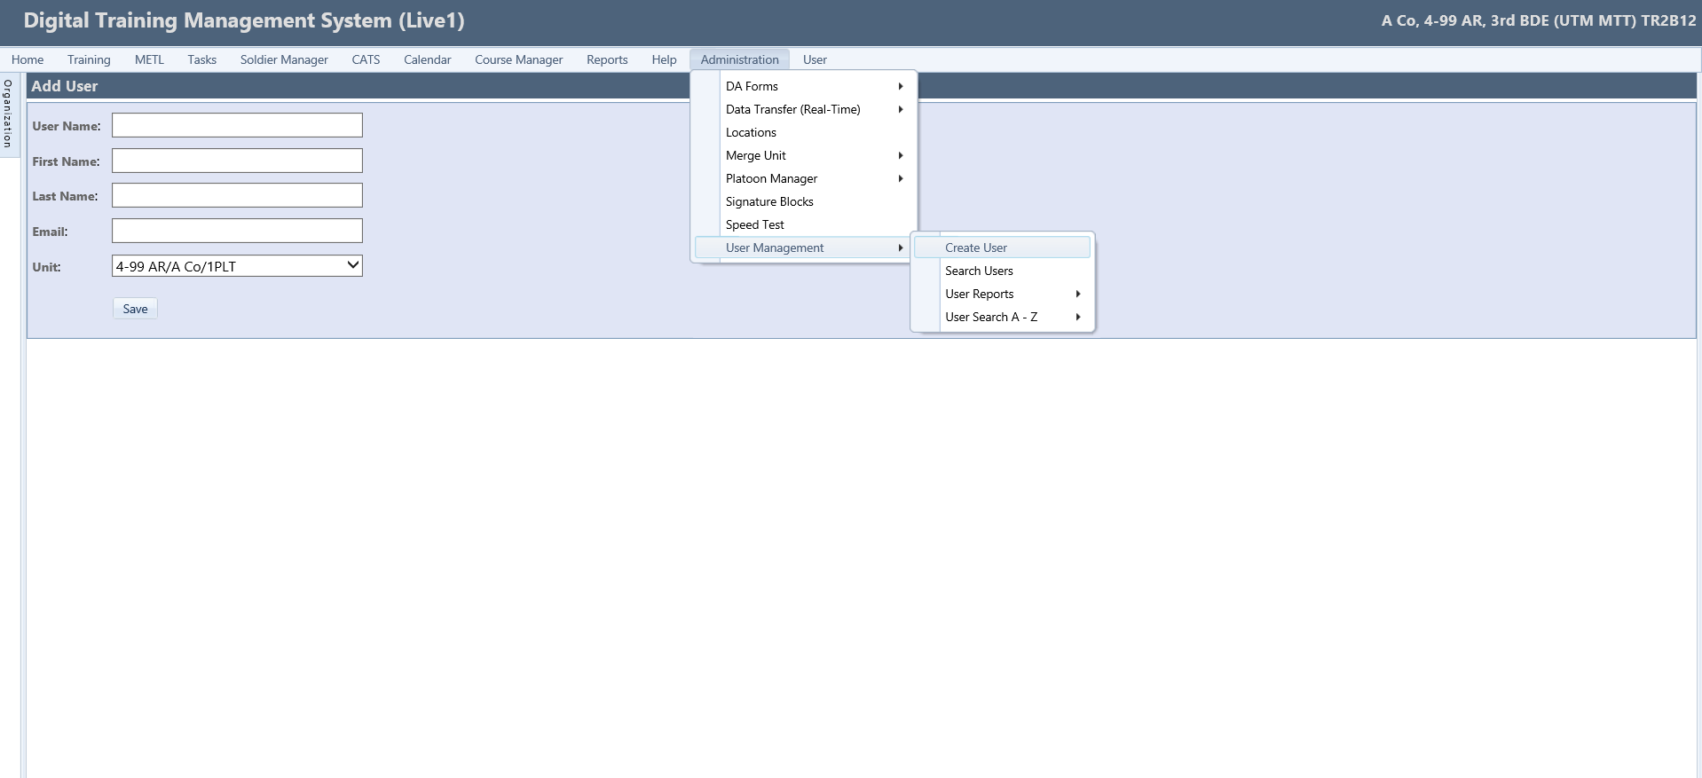
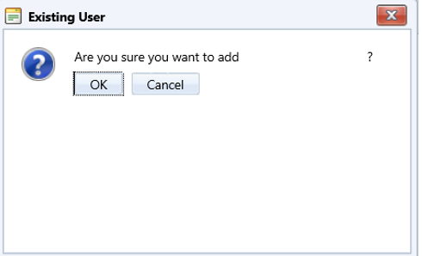
User Management Overview
To access the Create a User fly-out menu.
Navigate to the Administration menu, the drop-down submenu expands.
Hover cursor over the User Management submenu, the fly-out menu opens.
Click the Create a User fly-out menu.
The screen refreshes and the Add User window opens.
Paste the Username in the User Name text field.
Press Tab key on keyboard or click outside the test box to auto-populate the additional boxes.
Select the Unit from the drop-down menu.
Select the Save button.
A dialog box opens to confirm that you want to move the user.
Click the OK button to save.
The screen refreshes to the Edit User page.
NOTE
Granting Users access to a new unit will not deny them access to any other unit the user has access to.
16
Notes:
Reference: Digital Training Management System (https://dtms.army.mil).
INSTRUCTOR ONLY: The instructor/facilitator must demonstrate the functionality on a live network (depending on network availability). When network connectivity is not available, the instructor/facilitator must initiate contingency plan.
INSTRUCTOR NOTES:
User Management Overview
The User Management allows users the ability to create, edit, remove, and search DTMS Users with access to your unit. Not all users will have this menu option. This menu is roles based; in order to see / use this menu you must have the following individual permission: ManageUsers.
First, we will demonstrate how to Create a User.
To create a user, you must have the individual’s User Name exactly like it is recorded in ICAM. To verify the individual’s exact User Name you can follow
these steps to find it in ICAM:
Login to ICAM (https://www.icamportal.us.army.mil).
Select the “User Search” button in the middle of the screen; and use the search filters to locate the Soldier’s ICAM record for whom they are granting access. In the search’s return on ICAM, DTMS Managers will then see a column title “Legacy UID”, formerly referred to as the “AKO username” and it is what must be used to create the Soldier’s DTMS user account. For personnel that have joined the ARMY after 10 November of 2021 they will use the UID provided from the ICAM site.
Copy the User Name to be used in the next step.
NOTE
Granting Users access to a new unit will not deny them access to any other unit the user has access to.
Create a User
To access the Create a User fly-out menu.
Navigate to the Administration menu, the drop-down submenu expands.
Hover cursor over the User Management submenu, the fly-out menu opens.
Click the Create a User fly-out menu.
The screen refreshes and the Add User window opens.
Paste the Username in the User Name text field.
Press Tab key on keyboard or click outside the test box to auto-populate the additional boxes.
Select the Unit from the drop-down menu.
Select the Save button.
A dialog box opens to confirm that you want to move the user.
Click the OK button to save.
The screen refreshes to the Edit User page.
Next slide

Slide 17
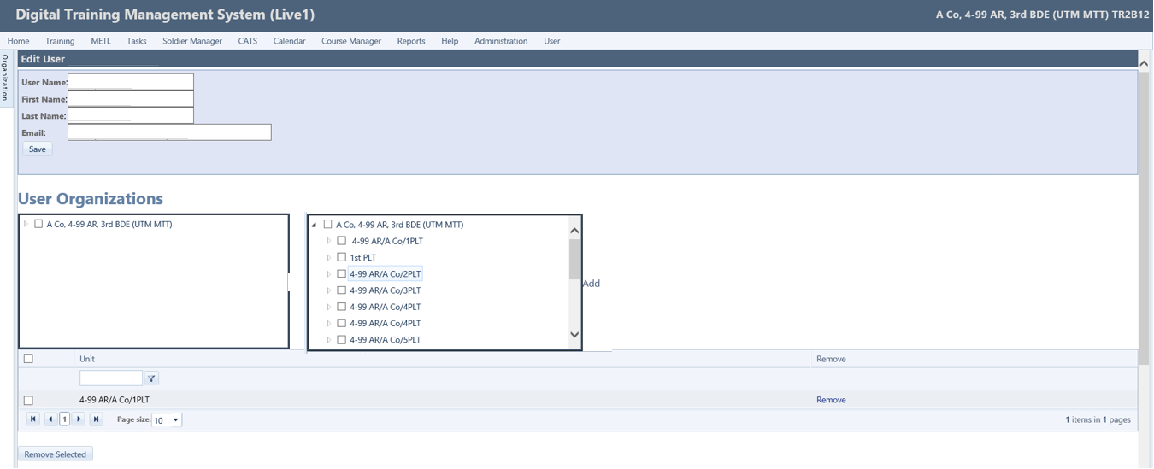
Create User
Step 3
Click the Add button.
The screen refreshes and display the units (in the table below) the user has access to.
Step 1
Click the triangle expander icon to view subordinate units.
Step 2
To select all units, place a checkmark in the top checkbox by parent unit.
To select individual units place checkmarks in the appropriate checkboxes.
17
Notes:
Reference: Digital Training Management System (https://dtms.army.mil).
INSTRUCTOR ONLY: The instructor/facilitator must demonstrate the functionality on a live network (depending on network availability). When network connectivity is not available, the instructor/facilitator must initiate contingency plan.
INSTRUCTOR NOTES:
Edit User Page
On the Edit User page you have the ability to add additional units to the user account from the User Organizations window, determine what type of access is needed by assigning groups to the user account from the User Groups window, and assign permissions to the user account from the User Permissions window.
Add User Organizations
Step 1
To add units, click the expand triangle icon next to the parent unit.
Step 2
To select all available units, place a checkmark in the top checkbox next to the parent unit. OR
To select individual units, place checkmarks in the appropriate checkboxes.
Step 3
Click the Add button, the screen refreshes and display the units the user has access to.
NOTE
This list can grow quite large, so you have the option of a filter selection at the top of the page above the unit name column to filter units down to be able to better manage them.
Next, we will demonstrate how to add User Groups.
Next slide

Slide 18
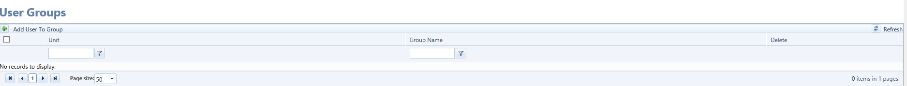
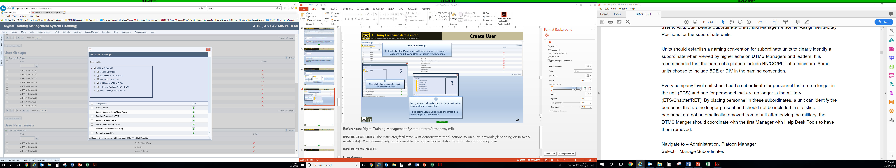
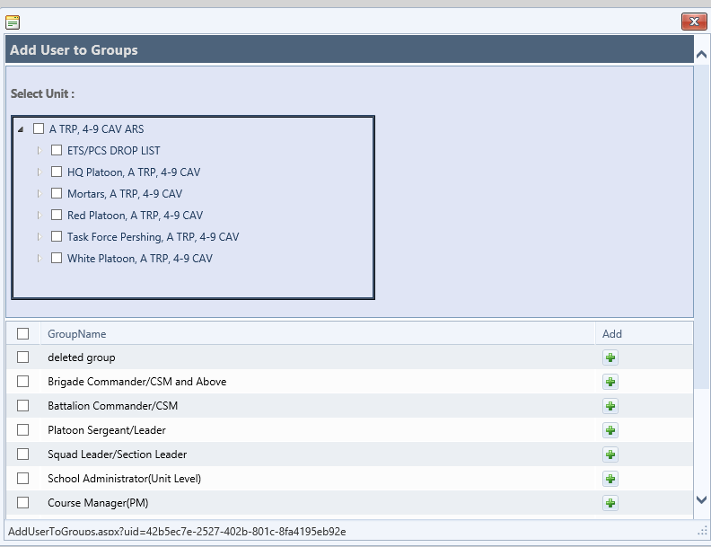
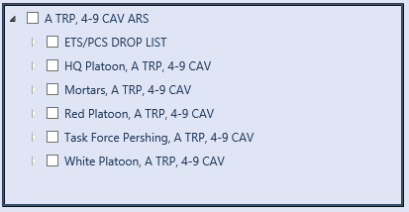
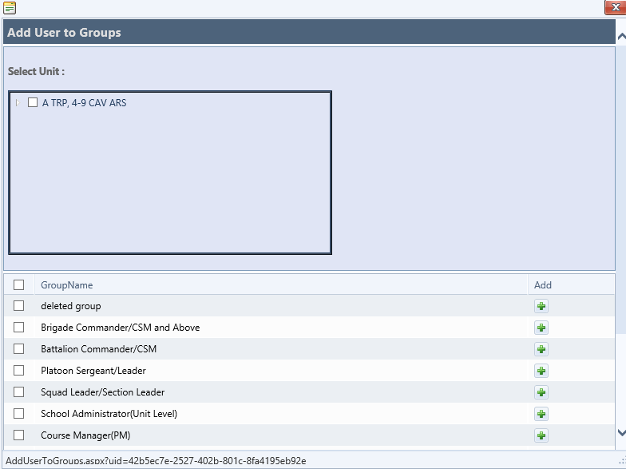

Create User
Step 4
Click the Plus (+) icon to add user groups.
The screen refreshes and the Add User to Groups window opens.
Step 7
Scroll down the window, select the Page size drop-down menu, select 50. This option gives you max visibility of the group names. Place checkmarks in the following checkboxes:
Step 6
To select all units place a checkmark in the top checkbox by parent unit
To select individual units place checkmarks in the appropriate checkboxes.
CalendarMenu
CATSMenu
DAFormsMenu
ITSPMenu
DATA TransferMenu
PlatoonManagerMenu
PlatoonMenu
ReportingMenu
TrainingExecuteMenu
TrainingPlanMenu
TrainingPrepareMenu
Step 5
Next, click the triangle expander icon to view subordinate units.
18
Notes:
Reference: Digital Training Management System (https://dtms.army.mil).
INSTRUCTOR ONLY: The instructor/facilitator must demonstrate the functionality on a live network (depending on network availability). When network connectivity is not available, the instructor/facilitator must initiate contingency plan.
INSTRUCTOR NOTES:
User Groups
Determine what type of access is needed by assigning groups to the user. The User to Groups window allows you to customize the access to the units you previously selected. Place a checkmark only on Common Access group. This one group gives all of the permissions necessary for any echelon.
Add User to Groups
Step 4
Click the Plus (+) icon to add user groups.
The screen refreshes and the Add User to Groups window opens.
Step 5
Click the triangle expander icon to view subordinate units.
Step 6
To select all units, place a checkmark in the top checkbox next to parent unit. OR
To select individual units, place checkmarks in the appropriate checkboxes.
Step 7
Scroll down the window, select the Page size drop-down menu, select 50. This option gives you max visibility of the group names. Place checkmarks in the following checkboxes:
NOTES
The list is not in alphabetical order. These are the most common functions at company, battalion, brigade and often at platoon.
CalendarMenu
CATSMenu
DAFormsMenu
ITSPMenu
DATA TransferMenu
PlatoonManagerMenu
PlatoonMenu
ReportingMenu
TrainingExecuteMenu
TrainingPlanMenu
TrainingPrepareMenu
Next, scroll down to bottom of window, select the Add Selected button (Not shown on illustration).
Screen refreshes, a dialog box opens to confirm your group assignments have been added.
Click the OK button.
Scroll down to bottom of window, select the Close button.
NOTE: Do not use the red “X” to exit the window. This is known to “NOT” save your work.
Are there any questions?
Next, we will demonstrate how to add User Permissions.
Next slide

Slide 19
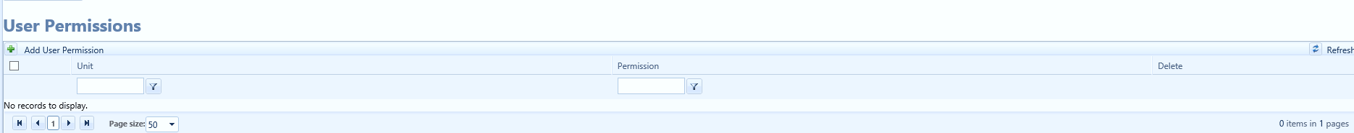
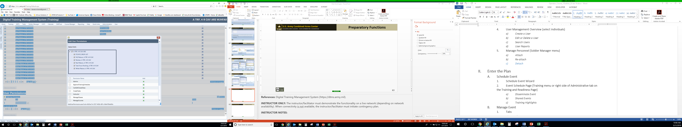
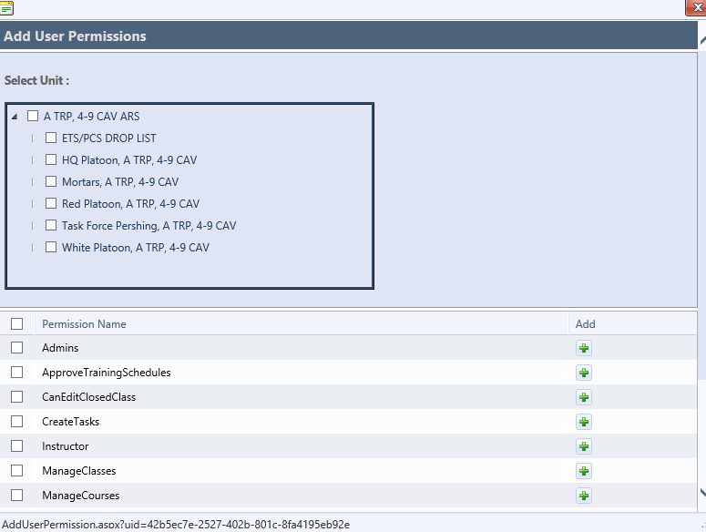
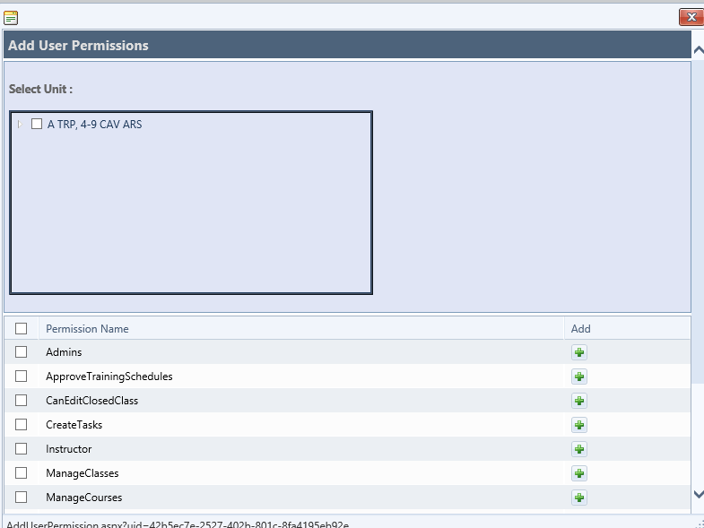

Create User
Step 8
Click the Plus (+) icon to add user permissions.
The screen refreshes and the Add User Permissions window opens.
Step 11
Scroll down the window, select the Page size drop-down menu, select 50. This option gives you max visibility of the permission names. Place checkmarks in the following checkboxes:
Next, scroll down to bottom of window, select the Add Selected button.
Click the OK button.
Scroll down to bottom of window, select the Close button.
Step 10
To select all units place a checkmark in the top checkbox by parent unit.
To select individual units place checkmarks in the appropriate checkboxes.
Step 9
Click the triangle expander icon to view subordinate units.
ManageUsers
SharedEventList
ManageCrew
ManageGunnerySettings
19
Notes:
Reference: Digital Training Management System (https://dtms.army.mil).
INSTRUCTOR ONLY: The instructor/facilitator must demonstrate the functionality on a live network (depending on network availability). When network connectivity is not available, the instructor/facilitator must initiate contingency plan.
INSTRUCTOR NOTES:
Add User Permissions
The only User Permission that should be added is the ManageUsers permission if the User needs the capability to Create Users or manage user accounts. There are some other User Groups and Permissions that are necessary for personnel using the Course Manager portion of DTMS.
Step 8
Click the Plus icon to add user permissions.
The screen refreshes and the Add User Permissions window opens
Step 9
Click the triangle expander icon to view subordinate units.
Step 10
To select all units, place a checkmark in the top checkbox next to parent unit. OR
To select individual units, place checkmarks in the appropriate checkboxes.
Step 11
Scroll down the window, select the Page size drop-down menu, select 50. This option gives you max visibility of the permission names. Place checkmarks in the following checkboxes:
NOTE 1
The list is not in alphabetical order.
ManageUsers
SharedEventList
ManageCrew
ManageGunnerySettings
NOTE 2
Ensure the permission “Admin” is UNCHECKED. This permission will add unnecessary tabs and menu options that the user does not need. If you do not want this account holder to have the ability to manage and create users accounts, ensure that you also uncheck “Manage Users.”
Next, scroll down to bottom of window, select the Add Selected button (Not shown on illustration).
NOTE 3
If the permissions are not on the current page, you must save your choices before going to the next page.
Screen refreshes, a dialog box opens to confirm your permission assignments have been added.
Click the OK button.
Scroll down to bottom of window, select the Close button.
NOTE 4
Do not use the red “X” to exit the window. This is known to “NOT” save your work.
Are there any questions?
Next, we will discuss/demonstrate how to Edit or Delete a User.
Next slide

Slide 20
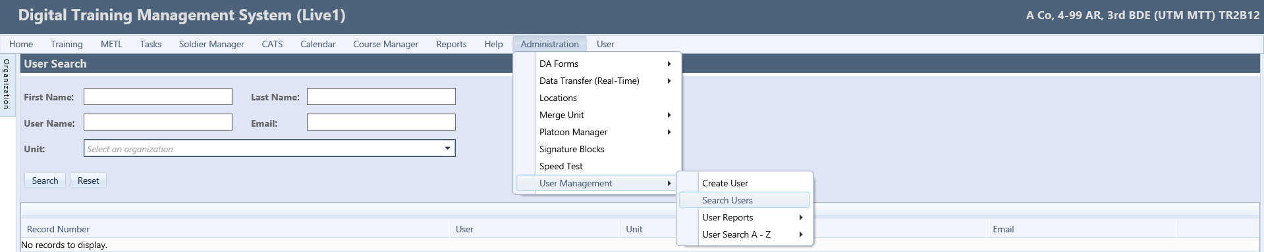
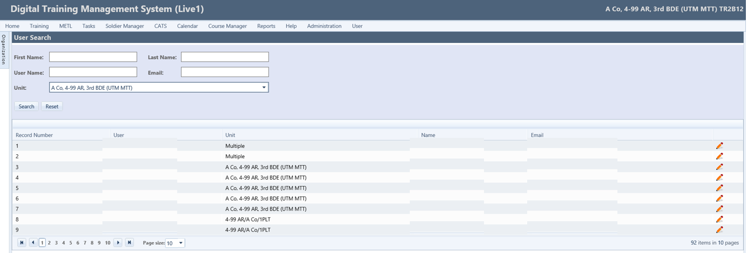
Search Users
Step 1
Navigate back to the Administration menu.
Scroll down to the Unit Management submenu.
Click the Search Users fly-out menu.
The screen refreshes and the User Search window opens.
Step 2
Search by Unit using the Unit drop-down menu.
Select the parent unit from the drop-down menu.
Click the Search button.
The table populates a list of all users with access to DTMS in the parent organization.
NOTE
The Pencil icon gives you access to the Edit User window to edit the user account.
20
Notes:
Reference: Digital Training Management System (https://dtms.army.mil).
INSTRUCTOR ONLY: The instructor/facilitator must demonstrate the functionality on a live network (depending on network availability). When network connectivity is not available, the instructor/facilitator must initiate contingency plan.
INSTRUCTOR NOTES:
Search Users
The Search Users allows you to search for a user in DTMS. This Search method should be regularly monitored to ensure personnel that are no longer in the unit do not retain access to DTMS and the Individual records that are accessible in DTMS.
Search for Users
Step 1
Navigate back to the Administration menu.
Scroll down to the Unit Management submenu.
Click the Search Users fly-out menu.
The screen refreshes and the User Search window opens.
Step 2
Search by Unit using the Unit drop-down menu.
Select the parent unit from the drop-down menu.
Click the Search button.
The table populates a list of all users with access to DTMS in the parent organization.
NOTE
The Pencil icon gives you access to the Edit User window to edit the user account (Not demonstrated on illustration).
Are there any questions?
Next, we will demonstrate how to Edit/delete user.
Next slide

Slide 21
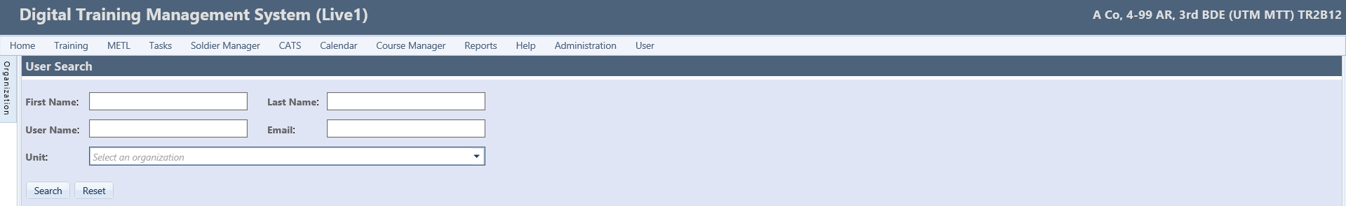
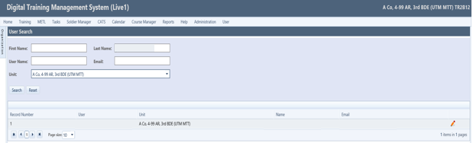
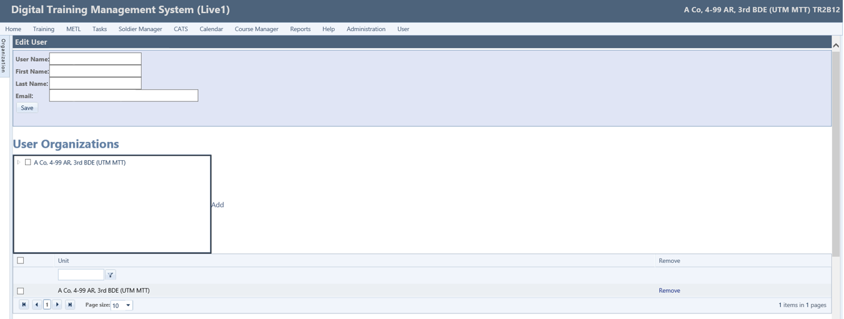
Edit/Delete User
Step 1
You must specify one of the following values: Unit, Last Name, First name, User Name, or Email Address.
Next, click the Search button. Screen refreshes and display the name in the grid.
Step 2
Click the Pencil icon.
Screen refreshes to the Edit User window.
Step 3
To delete user, select the Unit by placing a checkmark in the checkbox.
Click the Remove button, screen refreshes and removes the individual from unit.
Next, place checkmark in the checkbox underneath the User Groups table next to the Unit.
Click the Remove Selected button.
Next, place checkmark in the checkbox underneath the User Permissions table next to the Unit.
Click the Remove Selected button.
Click the Save button (near top of page).
NOTE
If there are 2 or more pages, click the Page Size drop-down and select 50.
21
Notes:
Reference: Digital Training Management System (https://dtms.army.mil).
INSTRUCTOR ONLY: The instructor/facilitator must demonstrate the functionality on a live network (depending on network availability). When network connectivity is not available, the instructor/facilitator must initiate contingency plan.
INSTRUCTOR NOTES:
Edit or Delete a User
Navigate back to the Administration menu.
Scroll down to the User Management.
Click the Search Users fly-out menu.
Screen refreshes to the User Search window.
Step 1
You must specify one of the following values: unit, last name, first name, user name, or email address.
Next, click the Search button.
Screen refreshes and display the name in the grid.
Edit
Step 2
To edit user, click the Pencil icon.
Screen refreshes to the Edit User window.
From this screen you can edit the User Group and permissions.
Delete
Step 3
To delete user, select the Unit by placing a checkmark in the checkbox.
Click the Remove button, screen refreshes and removes the individual from unit.
Next, place checkmark in the checkbox underneath the User Groups table next to the Unit.
Click the Remove Selected button.
Next, place checkmark in the checkbox underneath the User Permissions table next to the Unit.
Click the Remove Selected button.
Click the Save button (near top of page).
NOTE
If there are 2 or more pages, click the Page Size drop-down and select 50.
NOTE: The user may not disappear immediately from the list but should disappear within 24 hours.
Next, we will demonstrate the User Report functionality.
Next slide

Slide 22
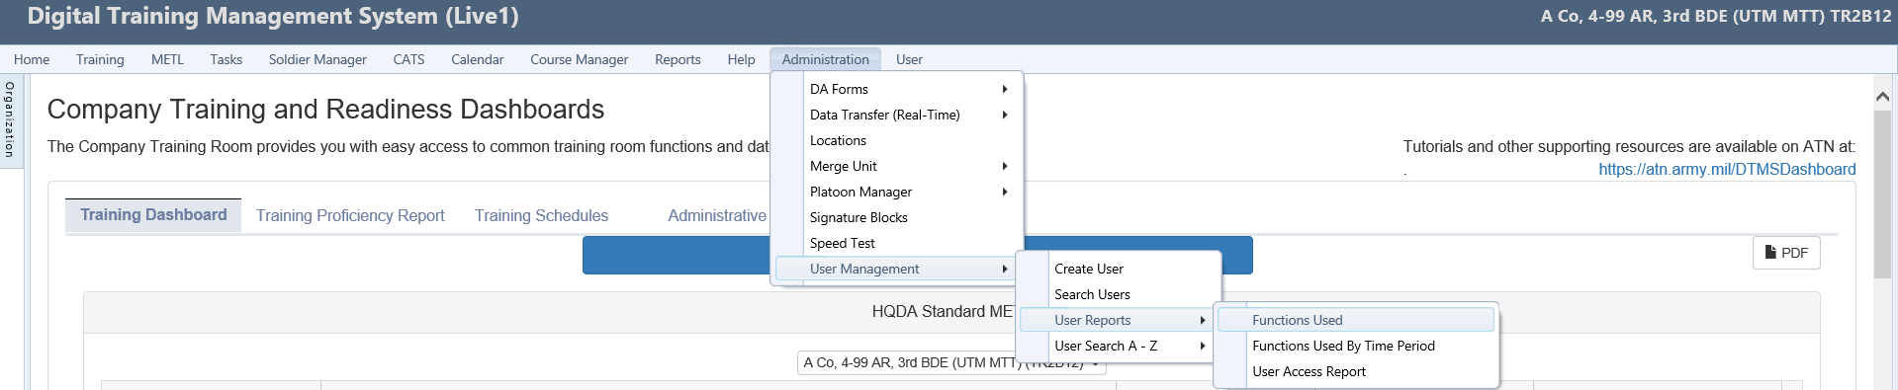
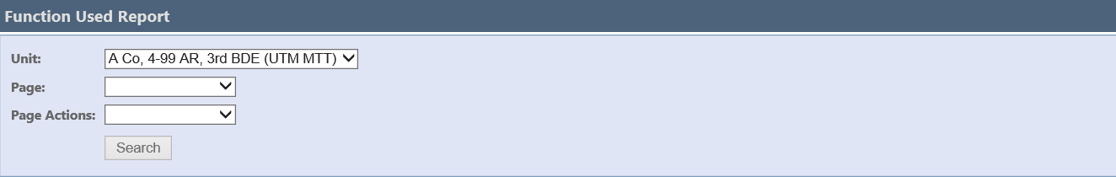
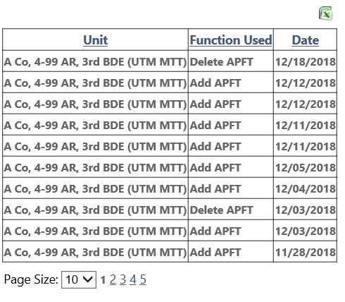
User Reports
Step 1
Navigate to the Administration menu.
Scroll down to the User Management.
Hover cursor over the Used Reports submenu.
Click the Functions Used fly-out menu.
Step 2
Select the Unit from the Unit drop-down menu.
Select a Page from the drop-down menu.
Select a Page Actions from the drop-down menu.
The screen refreshes, notice the Search button is now activated.
Click the Search button to view the search results.
The screen refreshes and the search results are displayed in an Excel table format.
Step 3
You have the option to view the number of items displayed by selecting from the Page Size drop-down menu. There is an option to generate an Excel spreadsheet by selecting the Excel icon.
22
Notes:
Reference: Digital Training Management System (https://dtms.army.mil).
INSTRUCTOR ONLY: The instructor/facilitator must demonstrate the functionality on a live network (depending on network availability). When network connectivity is not available, the instructor/facilitator must initiate contingency plan.
INSTRUCTOR NOTES:
User Reports
The User Reports menu allows you the ability to search for three different reports: Functions Used, Functions Used By Time Period, and User Access Report.
First, we will demonstrate the Functions Used report.
Step 1
To access the Functions Used fly-out menu.
Navigate to the Administration menu.
Scroll down to the User Management.
Hover cursor over the Used Reports submenu.
Click the Functions Used fly-out menu.
NOTE
The screen refreshes and the Functions Used Report window opens. Notice the Unit defaults to the unit you are logged into.
Step 2
Select the Unit from the Unit drop-down menu.
Select a Page from the drop-down menu.
Select a Page Actions from the drop-down menu.
The screen refreshes, notice the Search button is now activated.
Click the Search button to view the search results.
The screen refreshes and the search results are displayed in an Excel table format.
Step 3
You have the option to view the number of items displayed by selecting from the Page Size drop-down menu. There is an option to generate an Excel spreadsheet by selecting the Excel icon.
Are there any questions? …Solicit learner response and gain feedback from learning session (Below)
Solicit Learner Response and Gain Feedback: Ask the students an open-ended question about the topic. Encourage student dialogue and interaction with each other. The instructor will inject as required to assist learning and student engagement.
Next we will demonstrate the Functions Used by Time Period Report.
Next slide

Slide 23
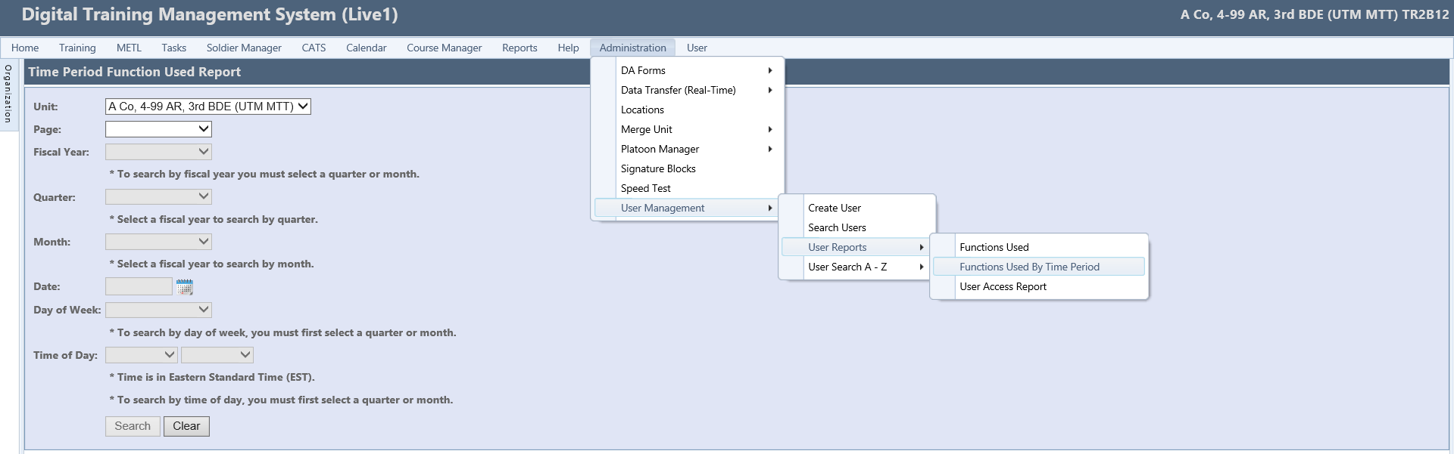
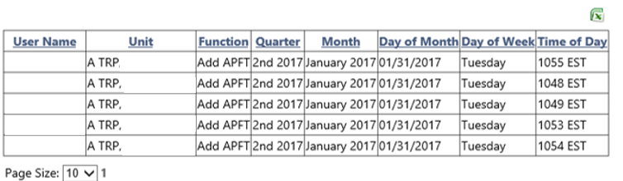
User Reports
Step 1
Navigate to the Administration menu.
Scroll down to the User Management.
Hover cursor over the User Reports submenu.
Click the Functions Used By Time Period fly-out menu.
Step 2
Select an option from the Page drop-down menu: APFT, Height/Weight, and Weapons.
Notice when the Page is selected, it activates the Fiscal Year drop-down menu and Date calendar menu.
Select the Fiscal Year drop-down menu, this is a mandatory field.
Notice when the Fiscal Year is selected, it activates the Quarter and Month drop-down menus. These fields become activated.
Select either the Quarter or Month from the drop-down menu. When you select either Quarter or Month it deactivates the other field.
Step 3
You have the option to view the number of items displayed by selecting from the Page Size drop-down menu. There is an option to generate an Excel spreadsheet by selecting the Excel icon.
23
Notes:
Reference: Digital Training Management System (https://dtms.army.mil).
INSTRUCTOR ONLY: The instructor/facilitator must demonstrate the functionality on a live network (depending on network availability). When network connectivity is not available, the instructor/facilitator must initiate contingency plan.
INSTRUCTOR NOTES:
Functions Used By Time Period
To access the Functions Used By Time Period fly-out menu.
Step 1
Navigate to the Administration menu.
Scroll down to the User Management submenu.
Hover cursor over the User Reports fly-out menu.
Click the Functions Used By Time Period fly-out menu.
The screen refreshes and the Time Period Function Used Report window opens.
Notice the Unit defaults to the unit you are logged into.
Step 2
Select an option from the Page drop-down menu: APFT, Height/Weight, and Weapons.
Notice when the Page is selected, it activates the Fiscal Year drop-down menu and Date calendar menu.
Select the Fiscal Year drop-down menu, this is a mandatory field.
Notice when the Fiscal Year is selected, it activates the Quarter and Month drop-down menus. These fields become activated.
Select either the Quarter or Month from the drop-down menu. When you select either Quarter or Month it deactivates the other field.
NOTE
To search by fiscal year, you must select a quarter or month. Select a fiscal year to search by quarter. Select a fiscal year to search by Month. When selected, it activates the Day of week drop-down menu.
Select the Calendar icon to select a Date. When the Day of Week is selected, it deactivates the Quarter and Month drop-downs.
To search by day of the week: select the Day of Week from the drop-down menu, this is not a mandatory field.
To search by time: select the Time of Day from the drop-down menu.
NOTE: Time is in Eastern Standard Time (EST), this is not a mandatory field.
Once you are satisfied with your selections, click the Search button to reveal your search results.
The screen refreshes and displays the results in the grid.
Step 3
You have the option to view the number of items displayed by selecting from the Page Size drop-down menu, and you have the option to generate an Excel spreadsheet by selecting the Excel icon.
Are there any questions?
Next slide

Slide 24
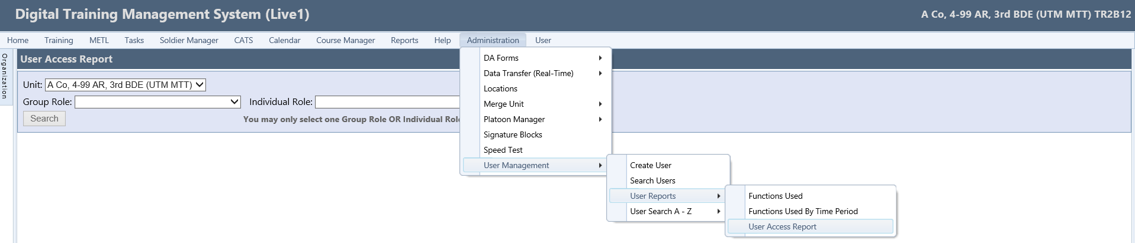
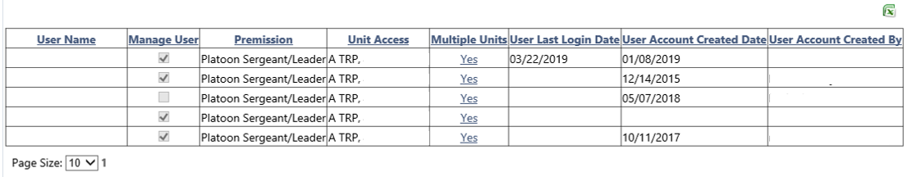
User Reports
Step 1
Navigate to the Administration menu.
Scroll down to the User Management submenu.
Scroll over to the User Reports fly-out menu.
Click the User Access Report fly-out menu.
The screen refreshes and the User Access Report window opens.
Step 2
Select either a Group Role or an Individual Role from the drop-down menu. It activates the Search button.
To reveal the results of the selected role, click the Search button.
The screen refreshes and displays the results in the grid.
Step 3
You have the option to view the number of items displayed by selecting from the Page Size drop-down menu and you have the option to generate an Excel spreadsheet by selecting the Excel icon.
24
Notes:
Reference: Digital Training Management System (https://dtms.army.mil).
INSTRUCTOR ONLY: The instructor/facilitator must demonstrate the functionality on a live network (depending on network availability). When network connectivity is not available, the instructor/facilitator must initiate contingency plan.
INSTRUCTOR NOTES:
User Access Report
To access the User Access Report fly-out menu.
Step 1
Navigate to the Administration menu.
Scroll down to the User Management submenu.
Scroll over to the User Reports fly-out menu.
Click the User Access Report fly-out menu.
The screen refreshes and the User Access Report window opens.
NOTE
You have the ability to select a Unit, a Group Role, or the Individual Role from the drop-down menus. The Unit is populated with your current unit. Notice the Search button is deactivated.
Step 2
Select either a Group Role or an Individual Role from the drop-down menu. It activates the Search button.
To reveal the results of the selected role, click the Search button.
The screen refreshes and displays the results in the grid.
Step 3
You have the option to view the number of items displayed by selecting from the Page Size drop-down menu, and you have the option to generate an Excel spreadsheet by selecting the Excel icon.
Are there any questions?
Next, we will demonstrate Manage Personnel from the Soldier Manager menu.
Next slide

Slide 25
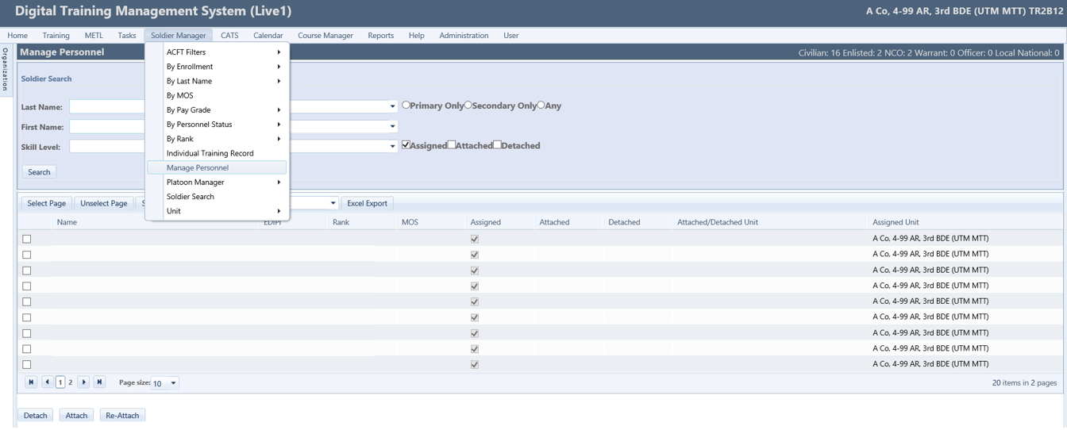
Manage Personnel
Step 1
Enter your search criteria using the filters to conduct a specific search, or click the Search button to view all personnel in the organization you are logged into.
Step 2
Select the appropriate training type from the drop-down menu.
Select Soldiers by placing checkmarks in the checkboxes next to the desired Soldiers names.
Next, select the Excel Export icon
Notes:
Reference: Digital Training Management System (https://dtms.army.mil).
INSTRUCTOR ONLY: The instructor/facilitator must demonstrate the functionality on a live network (depending on network availability). When network connectivity is not available, the instructor/facilitator must initiate contingency plan.
INSTRUCTOR NOTES:
Manage Personnel
Actions taken using Manage Personnel do not constitute actual personnel moves. Only personnel actions through ITAPdb can change a Soldier's UIC assignment. This role is designed to help units manage the training records of attachments and Soldiers transitioning into or out of the unit until actual personnel actions are reflected in DTMS.
Navigate to the Soldier Manager menu.
Scroll down and click the Manage Personnel submenu.
The screen refreshes and the Manage Personnel window opens.
The Manage Personnel Soldier Search page contains multiple filters by which the user can select from to locate the desired Soldier(s). These filters include Last Name, First Name, Skill Level, MOS, Rank, and Organization along with the MOS filters of Primary Only, Secondary Only, and Any, and personnel status filters of Assigned, Attached, and Detached.
Step 1
Enter your search criteria using the filters to conduct a specific search, or click the Search button to view all personnel in the organization you are logged into.
Step 2
To create an Excel Real-Time Data Transfer template.
Select the appropriate training type from the drop-down menu.
Select Soldiers by placing checkmarks in the checkboxes next to the desired Soldiers.
Next, select the Excel Export icon, Excel spreadsheet opens, save spreadsheet to your local computer to be used in a later lesson.
Are there any questions?
Next, we will demonstrate how to Attach personnel.
Next slide

Slide 26
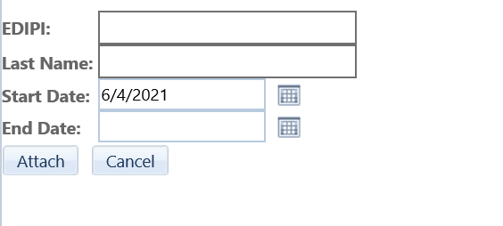
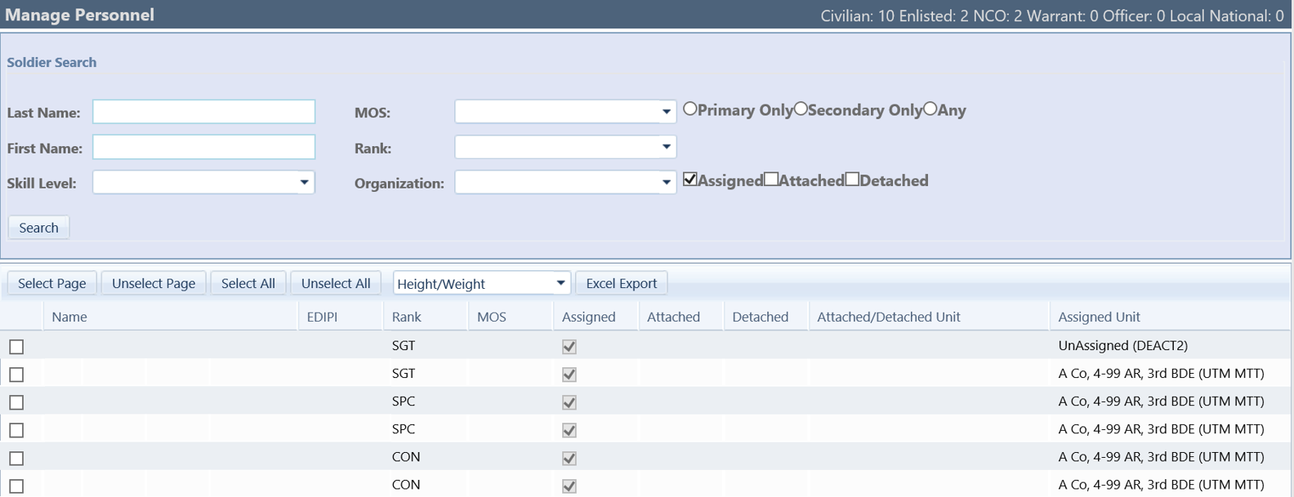
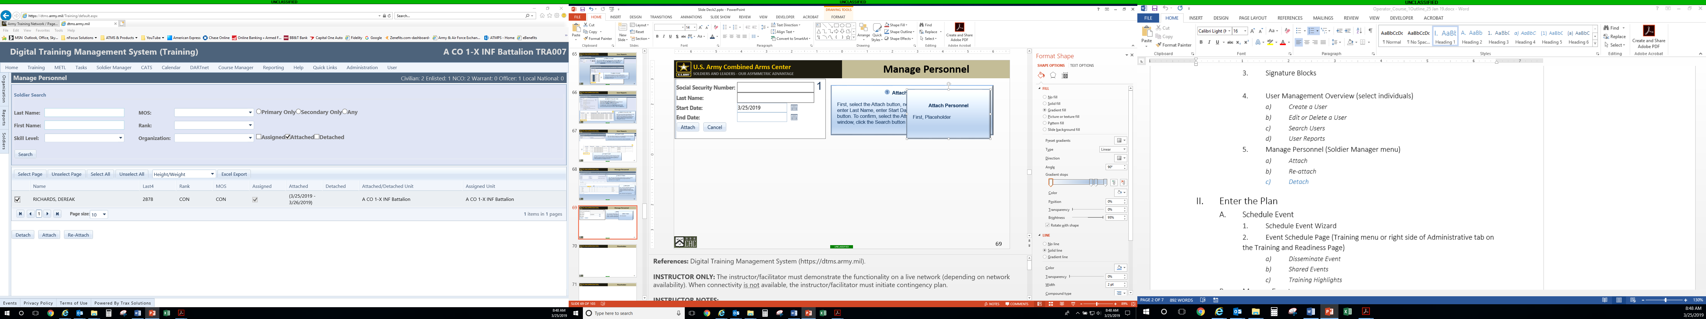
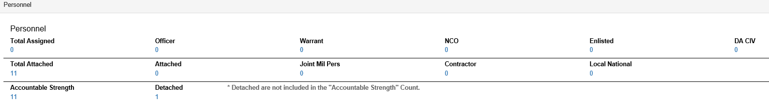
Manage Personnel
Attach Personnel
First, enter full EDIPI, enter Last Name, enter Start Date, enter End Date, click the Attach button.
To confirm, select the Attached checkbox in the Soldier Search window, click the Search button.
NOTE 1
Once the user has attached the personnel, the personnel’s training record will then be available as attached to the unit; and the training record will be automatically counted as detached from their assigned unit.
Re-Attach Personnel
Next, place a checkmark in the Attach checkbox in the Soldier Search window.
Next, click the Search button, screen refreshes and displays name(s).
Next, place checkmark(s) in the checkbox(es) next to the personnel name(s).
Click the Re-Attach button.
NOTE 2
The user can confirm the attachment by selecting the Administrative tab from the home menu, and scrolling down to the Personnel section.
Notes:
Reference: Digital Training Management System (https://dtms.army.mil).
INSTRUCTOR ONLY: The instructor/facilitator must demonstrate the functionality on a live network (depending on network availability). When network connectivity is not available, the instructor/facilitator must initiate contingency plan.
INSTRUCTOR NOTES:
Attach Soldier
This function gives you the ability to attach a Soldier not in the unit’s UIC but is participating in training events and needs
their training recorded in DTMS.
To begin, select the Attach button, the attachment window opens.
Enter full Social Security Number (no hyphens).
Enter Last Name
Enter Start Date.
Enter End Date.
Click the Attach button.
The screen refreshes and the personnel is attached to the unit.
To confirm, select the Attached checkbox in the Soldier Search window, click the Search button.
NOTE 1
Once the user has attached the personnel, the personnel’s training record will then be available as attached to the unit; and the training record will be automatically counted as detached from their assigned unit.
NOTE 2
The user can confirm the attachment by selecting the ‘Administrative’ tab from the home menu, and scrolling down to the ‘Personnel’ section.
Next, we will demonstrate how to re-attach personnel.
Re-Attach Personnel
Re-Attach function is best performed at the company level. This allows Users to return personnel to the UIC to which they belong in ITAPdb. This is the proper way to release personnel that have been attached to the unit and this is the way to return
personnel from a detached status and allow the system to place them where they should be according to UIC.
First, you must check the Attach checkbox in the Soldier Search window.
Next, click the Search button, screen refreshes and displays name(s).
Next, place checkmark(s) in the checkbox(es) next to the personnel name(s).
Click the Re-attach button.
NOTE: If this does not remove them from the status of Detached or Attached, contact the Help Desk for assistance.
Are there any questions?
Next, we will discuss how to Detach personnel.
Detach Personnel
NOTE: The Detach personnel functionality is not recommend to use to detach personnel.
Detach button is a holdover from previous versions of DTMS. The intended use of this function is no longer viable. DO NOT detach personnel in DTMS. This is NOT the way to clean up the personnel in the unit. By detaching personnel, the personnel
become invisible and cannot be managed properly by the automated systems in place and moved to the correct unit based on their UIC. This does not improve your statistics and should not be done.
Are there any questions?
Next, we will introduce the supporting products for this lesson.
Next slide

Slide 27




Supporting Products
Tutorials that support this lesson can be accessed using the buttons below
Requirements to view and download the Preparatory Functions tutorials:
Internet with EAMS-A Single Sign-On Required
Slide must be in Slide Show view
27
Notes:
INSTRUCTOR ONLY: If time permits, the instructor may demonstrate the supporting products.
INSTRUCTOR NOTES: The tutorials can be found on the DTMS Knowledge Base. The buttons link to PowerPoint tutorials for this lesson. Students are encouraged to review these tutorials. The tutorials can be used as refresher training.
Are there any questions?
Next, we will conduct a check on learning.
Next slide

Slide 28
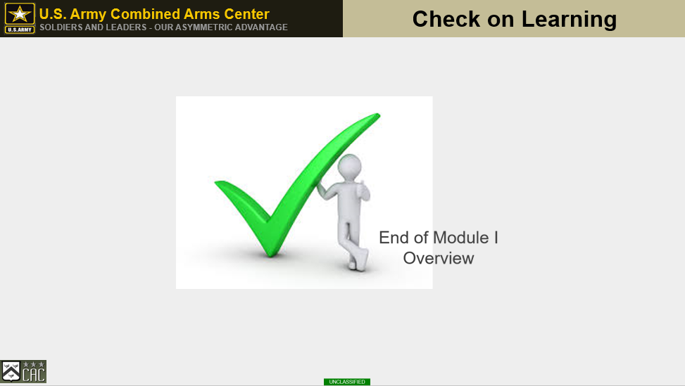
28
Notes:
References: Digital Training Management System (https://dtms.army.mil).
INSTRUCTOR ONLY: Determine if students have gained familiarity with the material discussed by soliciting student questions and explanations. Ask the students questions and correct misunderstandings.
Next slide

Slide 29
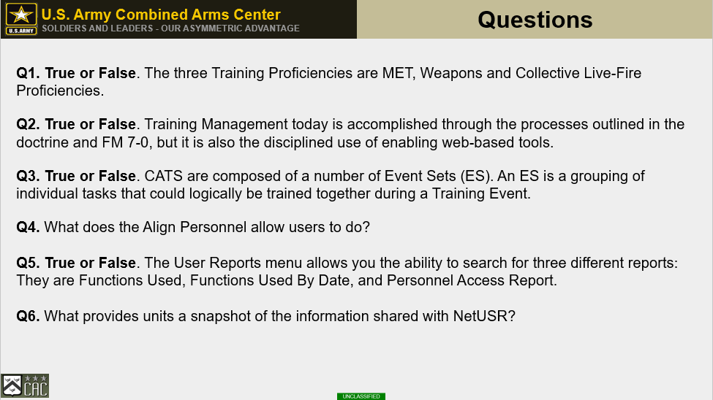
29
Notes:
References: Digital Training Management System (https://dtms.army.mil).
INSTRUCTOR ONLY: Determine if students have gained familiarity with the material discussed by soliciting student questions and explanations. Ask the students questions and correct misunderstandings.
INSTRUCTOR NOTES:
Q1. True or False. FM 7-0 supports the idea that training a unit does not fundamentally differ from preparing a unit for an operation.
Q2. True or False. Training Management today is accomplished through the processes outlined in the doctrine and FM 7-0, but it is also the disciplined use of enabling web-based tools.
Q3. True or False. CATS are composed of a number of Event Sets (ES). An ES is a grouping of individual tasks that could logically be trained together during a Training Event.
Q4. What does the Align Personnel allow users to do?
Q5. True or False. The User Reports menu allows you the ability to search for three different reports: They are Functions Used, Functions Used By Date, and Personnel Access Report.
Q6. What provides units a snapshot of the information shared with NetUSR?
Next slide

Slide 30
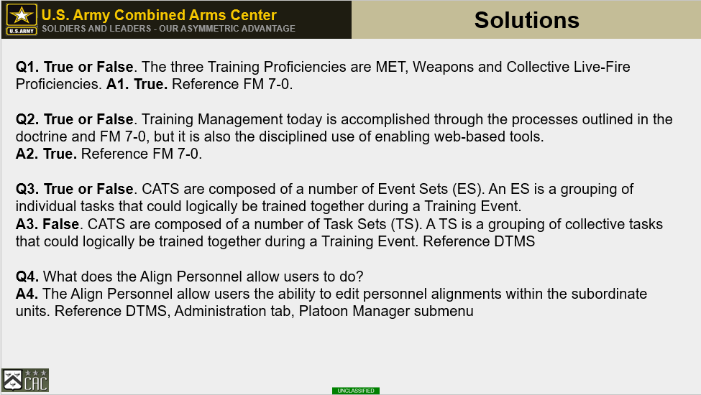
30
Notes:
References: Digital Training Management System (https://dtms.army.mil).
INSTRUCTOR ONLY: Determine if students have gained familiarity with the material discussed by soliciting student questions and explanations. Ask the students questions and correct misunderstandings.
INSTRUCTOR NOTES:
Q1. True or False. The three Training Proficiencies are MET, Weapons and Collective Live-Fire Proficiencies.
A1. True
Q2. True or False. Training Management today is accomplished through the processes outlined in the doctrine and FM 7-0, but it is also the disciplined use of enabling web-based tools.
A2. True
Q3. True or False. CATS are composed of a number of Event Sets (ES). An ES is a grouping of individual tasks that could logically be trained together during a Training Event.
A3. False. CATS are composed of a number of Task Sets (TS). A TS is a grouping of collective tasks that could logically be trained together during a Training Event.
Q4. What does the Align Personnel allow users to do?
A4. The Align Personnel allow users the ability to edit personnel alignments within the subordinate units. Reference DTMS, Administration tab, Platoon Manager submenu
Next slide

Slide 31
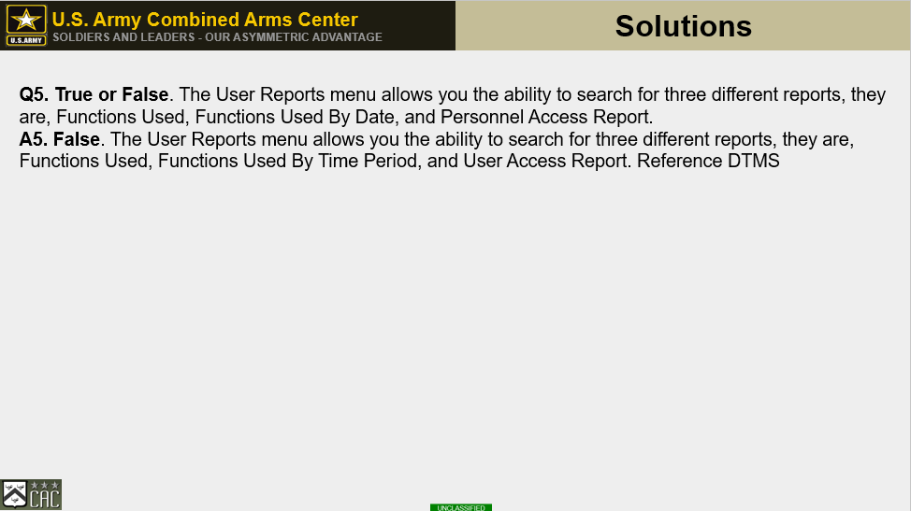
31
Notes:
References: Digital Training Management System (https://dtms.army.mil).
INSTRUCTOR ONLY: Determine if students have gained familiarity with the material discussed by soliciting student questions and explanations. Ask the students questions and correct misunderstandings.
INSTRUCTOR NOTES:
Q5. True or False. The User Reports menu allows you the ability to search for three different reports: They are Functions Used, Functions Used By Date, and Personnel Access Report.
A5. False. The User Reports menu allows you the ability to search for three different reports, they are, Functions Used, Functions Used By Time Period, and User Access Report.
This concludes the check on learning.
Are there any questions?

Slide 32
Practical Exercise
Practical Exercise
Divide into groups of no more than four people
The instructor will provide each group with a scenario
Each group will have 30 minutes to follow the directions provided in the scenario
Each group is encouraged to collaborate with each other while completing the scenario
Groups are allowed to communicate with other groups
After completing the scenario, take a break
32
Notes:
Instructor:
Walk around and monitor each group to assess their knowledge, performance, techniques, and offer assistance/guidance to concrete their knowledge and facilitate learning.

Slide 33
Practical Exercise Review
Practical Exercise Review
***NEEDS CREATED***
33
Notes:
Instructor:
Facilitate a group interactive review of the displayed scenario results
Learner's report should look identical to the displayed report
If any learner’s reports look different, analyze the discrepancy and provide insight to the learners to highlight the correct procedures

Slide 34
Hands-on Evaluation
Hands-on Evaluation
***NEEDS CREATED***
34
Notes:
Instructor:
Learners are provided a tablet and a controlled scenario with data they will input into DTMS
After entering the scenario data into DTMS, learners will generate a report as indicated in the scenario
After generating the report indicating that the learner has completed the evaluation, the instructor will evaluate the report and ensure accuracy and completeness

